Slide 1
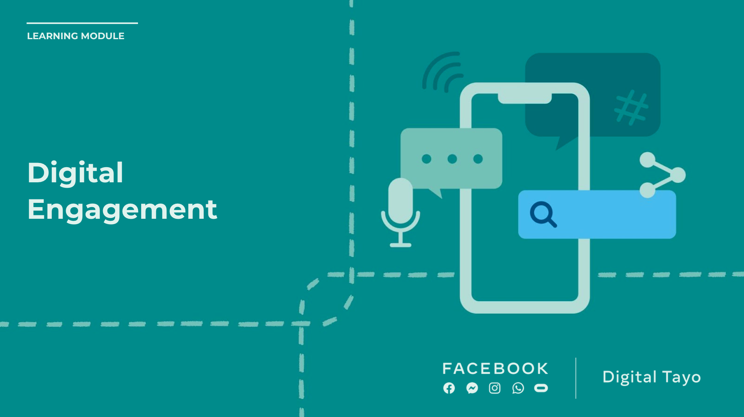
Notes:
Speaker Notes:
The lessons and activities in this section help students build safe, supportive, and inclusive online communities. A critical skill in this area is being able to identify and share reputable sources. Core skills include perspective-taking, critical thinking, respect and empathy, building healthy relationships, and media literacy.

Slide 2
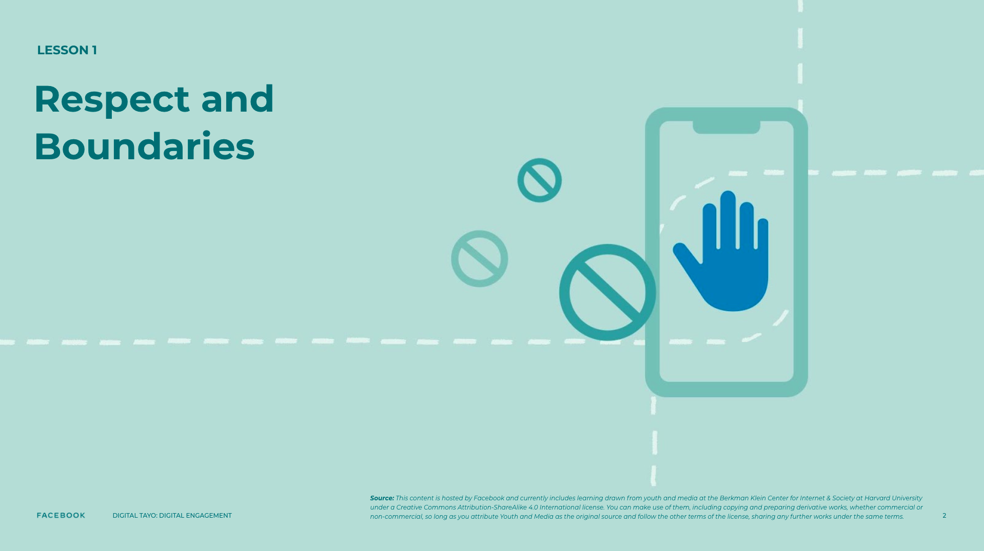
Notes:
Speaker Notes:
LESSON OBJECTIVE
Students will better understand others’ perspectives and feelings in the context of individuals sharing personal information online.
ESTIMATED TIME
55 Minutes
ESSENTIAL QUESTIONS
What does it mean for someone to cross your personal boundaries online?
MATERIALS
“Understanding and Sharing the Feelings of Others” Handouts
“Understanding and Sharing the Feelings of Others” Handout” - Educator’s Copies
PREPARATION
Print one handout per student.
OPTIONAL: ISTE DIGCITCOMMIT COMPETENCY
ENGAGED: I use technology and digital channels for civic engagement, to solve problems, and be a force for good in both physical and virtual communities.
INCLUSIVE: I am open to hearing and respectfully recognizing multiple viewpoints and I engage with others online with respect and empathy.

Slide 3
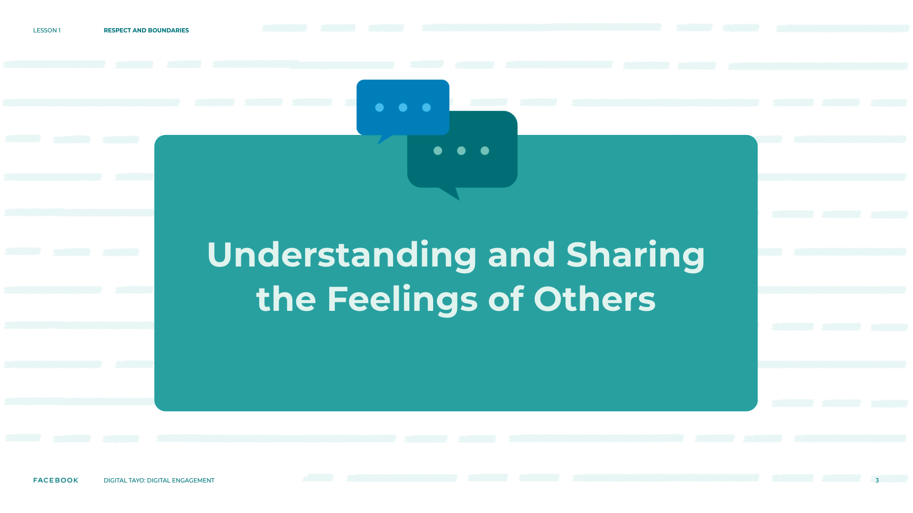
Notes:
Speaker Notes:
CLASS INTERACTION
Ask students to pair up and give each student a copy of the “Understanding and Sharing the Feelings of Others” handout. Allow students 15 minutes to read and discuss the scenarios. Walk around the room and help students with additional teacher prompts contained in the handout.

Slide 4
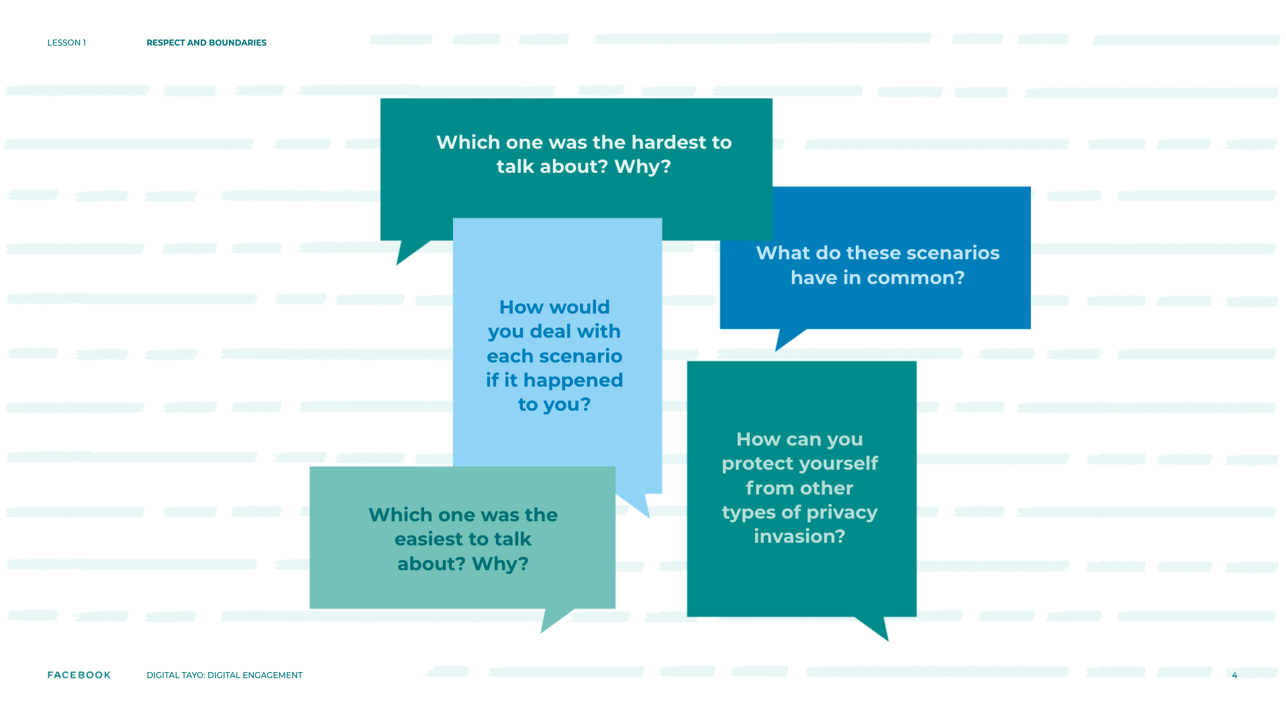
Notes:
Speaker Notes:
ASK YOUR STUDENTS
What do the scenarios have in common?
Which one was the hardest to talk about? The easiest? Why?
How would you address/deal with each of the scenarios were it to happen to you?
How can you protect yourself from other types of invasions of privacy?
TEACHER’S NOTE
For guidance on how to address/deal with each of the scenarios in the handout, please refer to the educator’s copy.

Slide 5
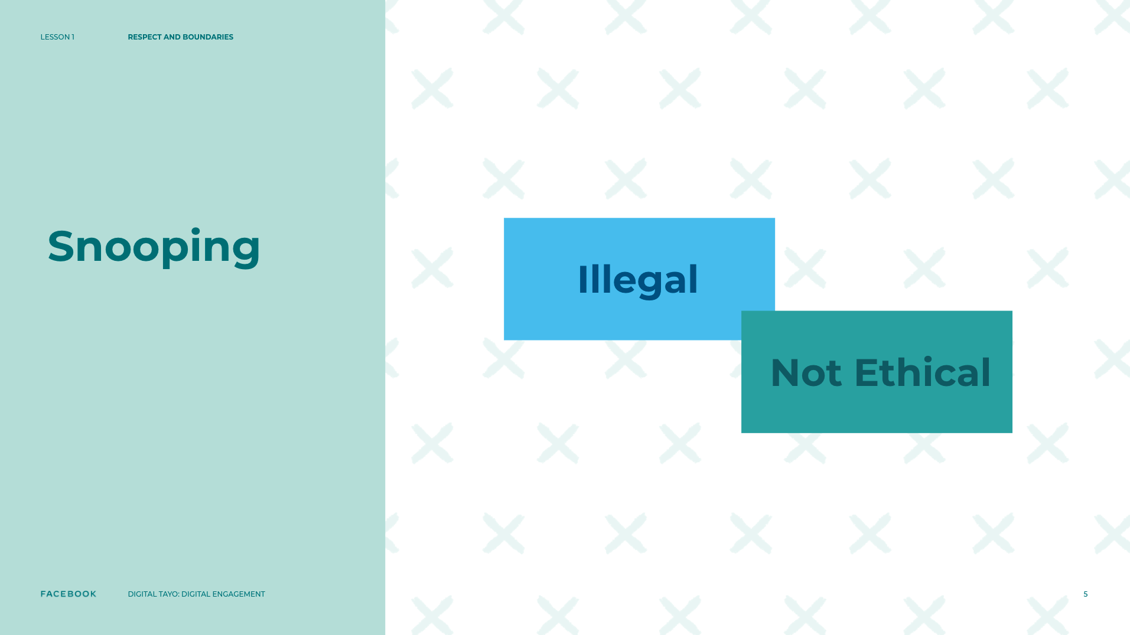
Notes:
Speaker Notes:
CLASS INTERACTION
Inform students that some forms of snooping are actually illegal, and, in nearly all cases, snooping is probably not ethical. In different kinds of relationships, people want to share various pieces of information about themselves. This variation is reasonable and normal. It is also reasonable and normal for one person to think an action is acceptable but for someone else to be less comfortable with it.
TEACHER’S NOTE
The concept of ethics is complex, and might need to be unpacked with your students, if needed.

Slide 6
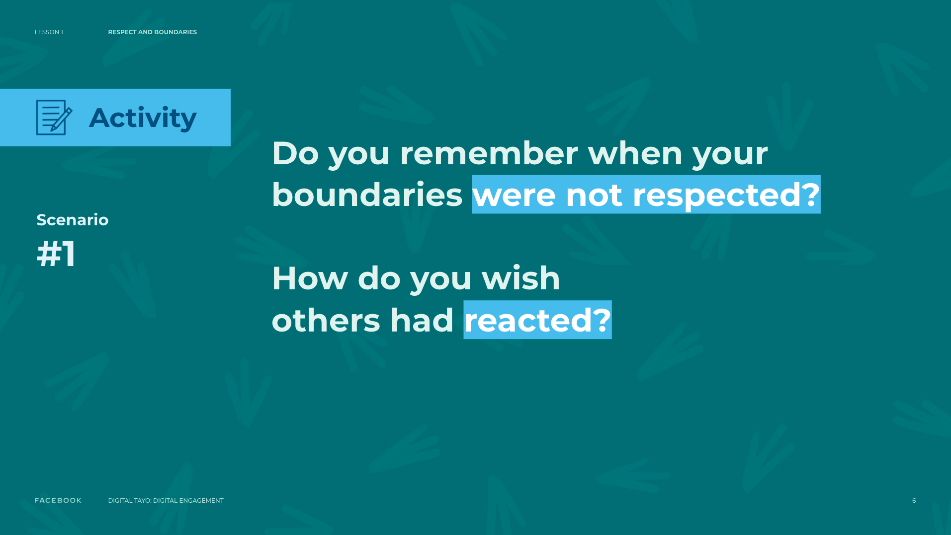
Notes:
Speaker Notes:
OPTIONAL ASSIGNMENT
TELL YOUR STUDENTS
Now we are going to extend the scenarios we just talked about. On your sheet of paper, draw two separate comic strips (if students are not excited about the idea of a comic strip, suggest that they write a short story instead), illustrating:
A scenario where you feel like your boundaries or someone else’s were not respected and how you wish others had reacted
A different scenario where you feel like your boundaries or someone else’s were respected and how others showed respect and kindness
Give students 30 minutes to finish their comics.
TEACHER’S NOTE
Sharing information on when someone’s boundaries were not respected may touch on sensitive issues for your students. Be prepared to listen and provide safeguarding resources for your students, if needed.

Slide 7
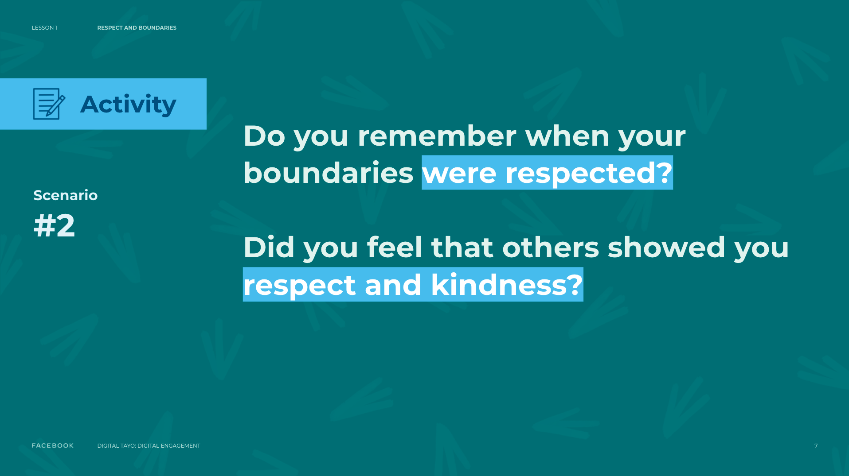
Notes:
Speaker Notes:
OPTIONAL ASSIGNMENT
TELL YOUR STUDENTS
Now we are going to extend the scenarios we just talked about. On your sheet of paper, draw two separate comic strips (if students are not excited about the idea of a comic strip, suggest that they write a short story instead), illustrating:
A scenario where you feel like your boundaries or someone else’s were not respected and how you wish others had reacted
A different scenario where you feel like your boundaries or someone else’s were respected and how others showed respect and kindness
Give students 30 minutes to finish their comics.
TEACHER’S NOTE
Sharing information on when someone’s boundaries were not respected may touch on sensitive issues for your students. Be prepared to listen and provide safeguarding resources for your students, if needed.

Slide 8
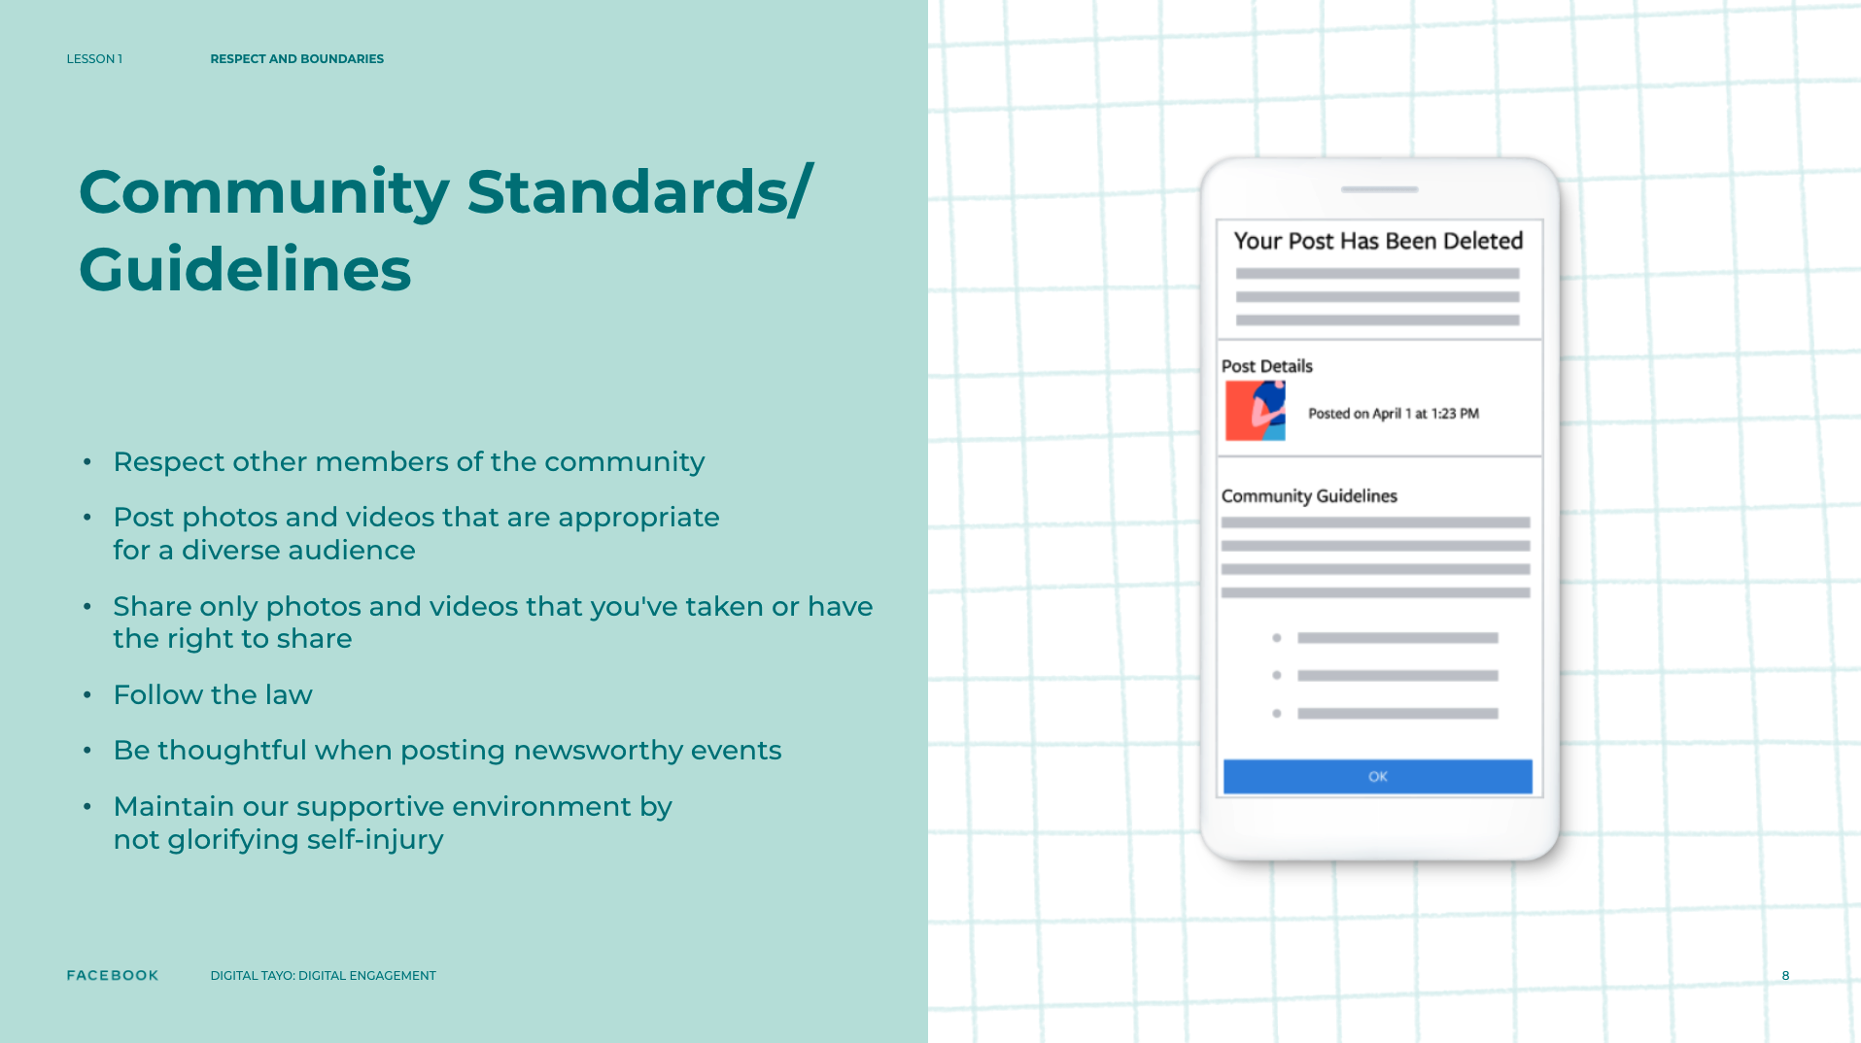
Notes:
Speaker’s Notes
TELL YOUR STUDENTS
Community Standards/Guidelines are a set of rules the Facebook company put in place that determine what is and isn’t allowed on Facebook and Instagram.
They’re at the heart of how Facebook and Instagram think about safety.
To develop policies Facebook and Instagram identify issues, work with outside experts on solutions, and then craft policies and operational support to make sure those issues are addressed.
There are a number of ways that Facebook and Instagram's products and ecosystems differ, but when it comes to what is and isn't allowed on the platforms, the policies are the same.
The key area where Facebook and Instagram differ is that Instagram does not require you to set up an account using your real name.
Instagram is a place where anyone can express themselves, whether on behalf of their pet hedgehog or someone who may be questioning their sexuality and might not be ready to come out using their real name.
Policies try to balance freedom of expression and safety, but doing this for a community of a billion people from all corners of the world will always be challenging.
In-app reporting allows anyone to report anything to us — from Stories to Explore content — if they think it breaks the rules.
Real people working 24/7 who review reports and take action accordingly, and AI technology trained to proactively find rule-breaking content, and alert the Facebook company’s teams so they can take appropriate action.

Slide 9
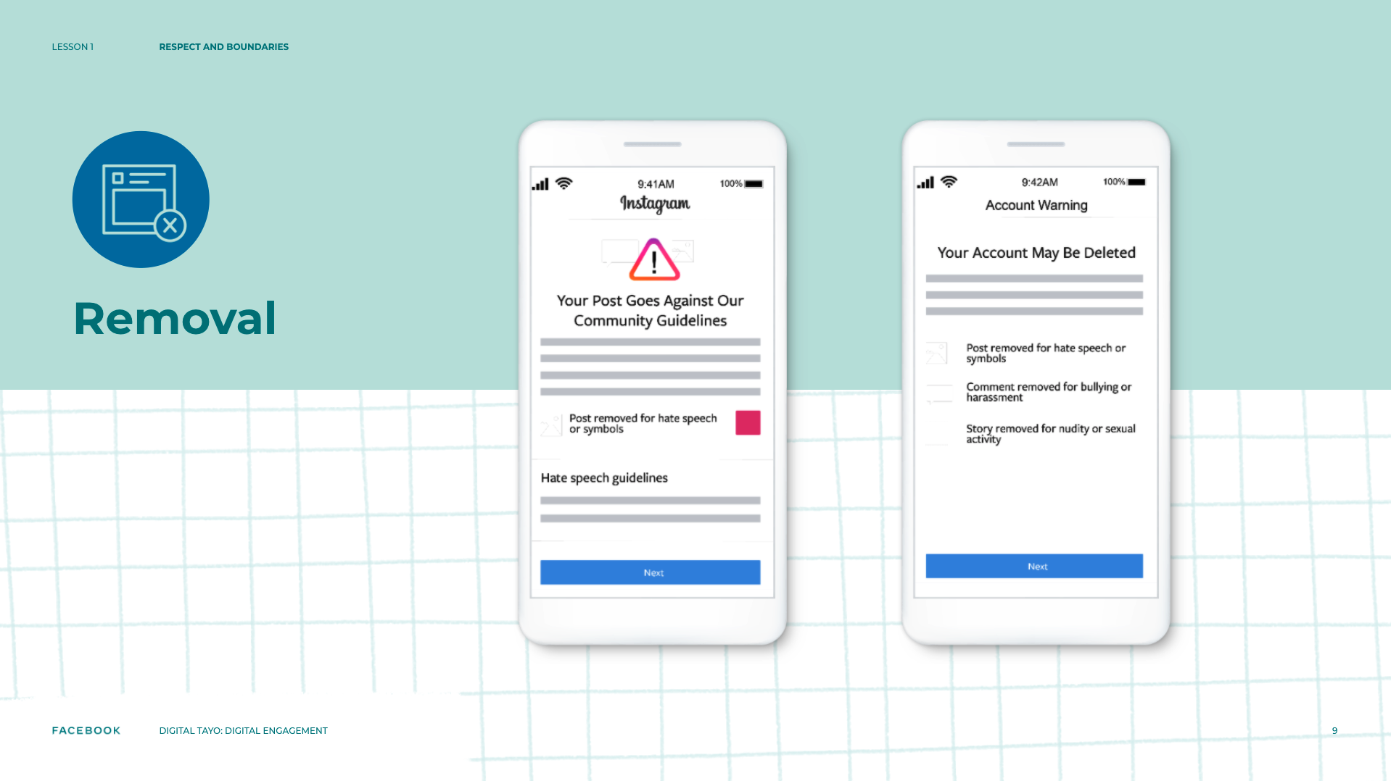
Notes:
Speaker’s Notes
TELL YOUR STUDENTS
When you violate the community guidelines your content might be deleted/removed (or Facebook may ask you to)
If you do not remove it on your own, it may impact your access.
If someone notices their account is no longer active, the account may have been removed by Facebook due to misuse.
Facebook is re-evaluating when an account should be removed from Instagram.
Accounts are now removed after a certain number of violations within a window of time.

Slide 10
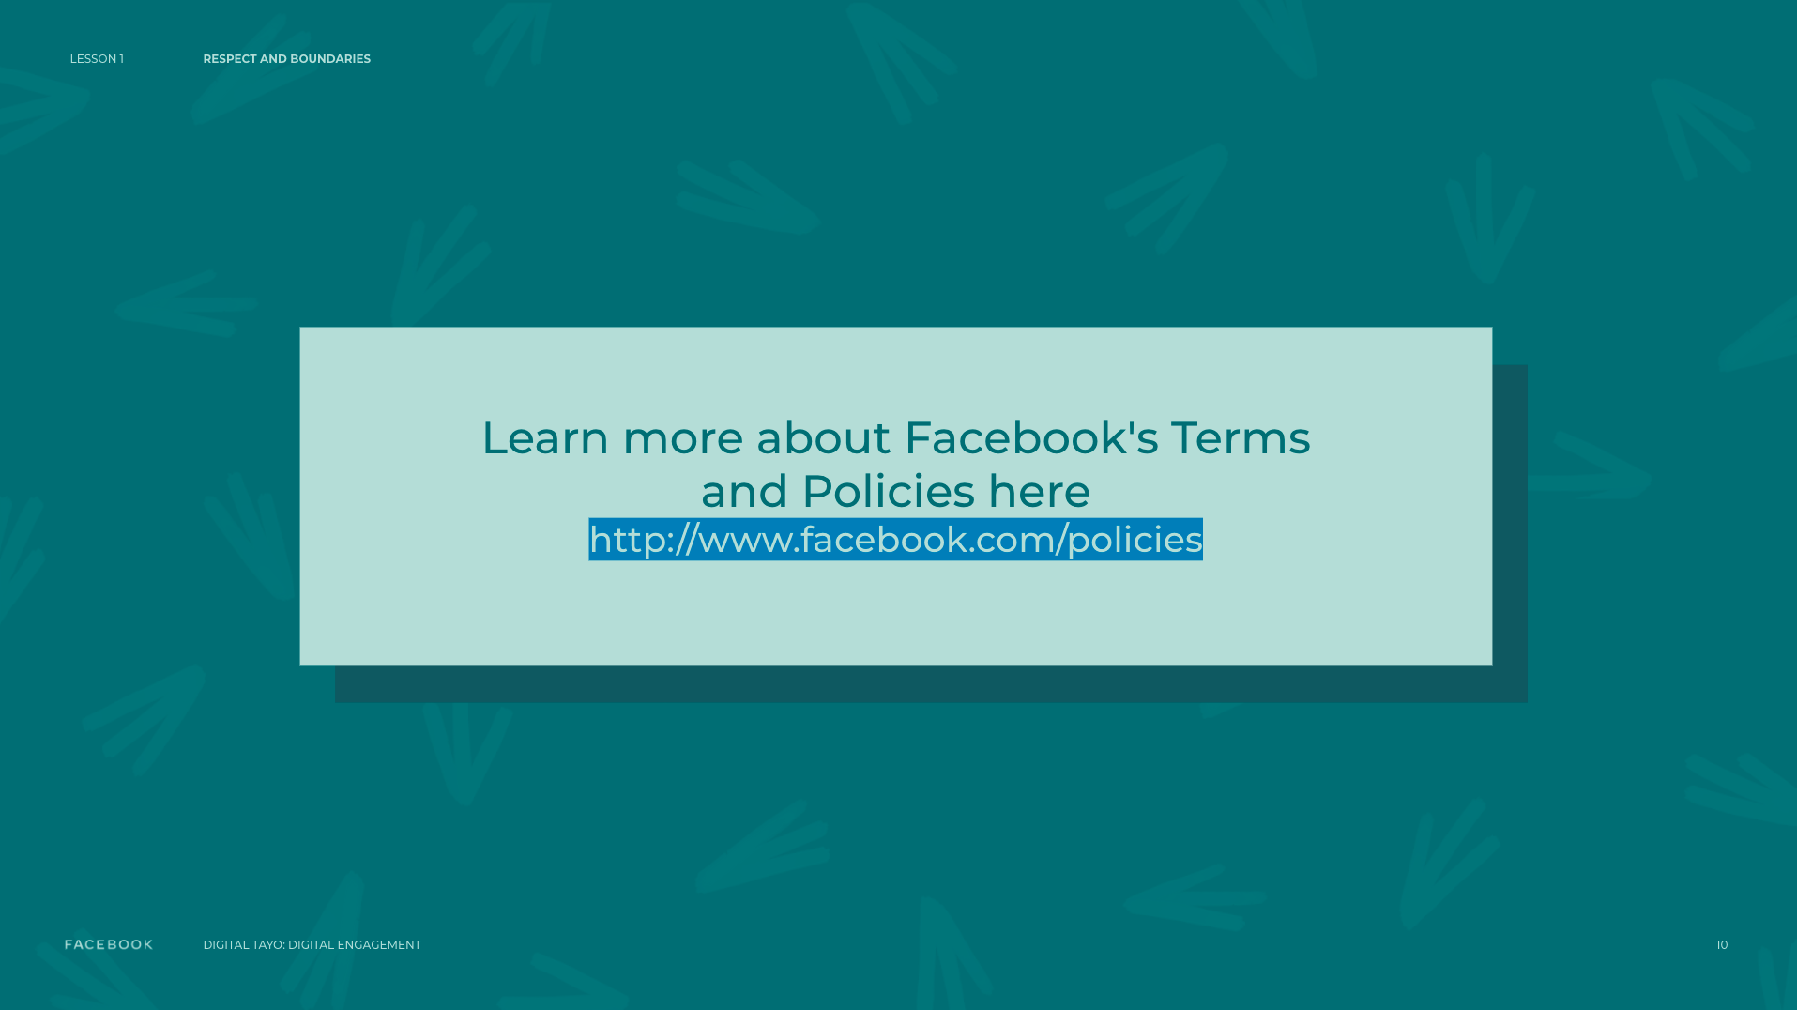
Notes:
Speaker’s Notes
We’ve talked about some boundaries to consider when you are engaging online, but it’s useful to remember that there are rules and policies set by others in the digital world too.
You don’t set them, but you need to follow them if you want to use some services or platforms.

Slide 11
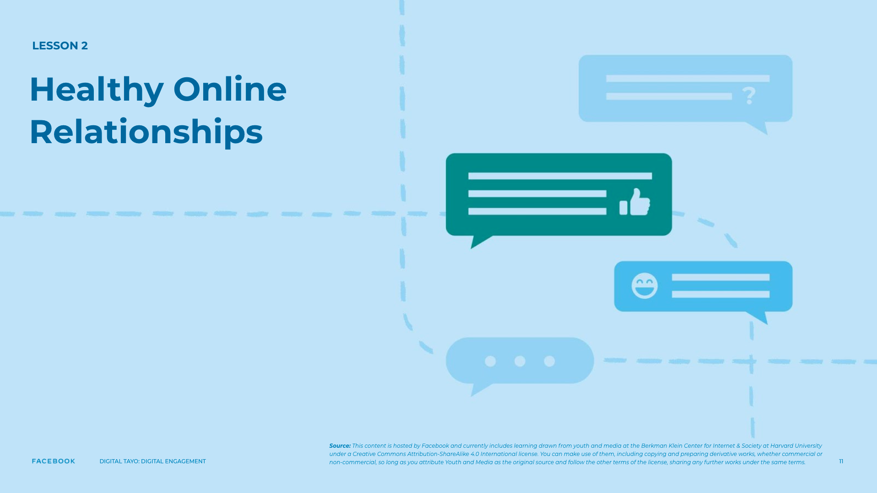
Notes:
Speaker Notes:
LESSON OBJECTIVE
Students will explore qualities that constitute healthy and kind relationships and how online behaviors play a role in both healthy and unhealthy relationships. Students will also examine the opportunities and challenges around the intersection between social media and relationships in their own peer group and learn how to promote “upstanding” among their peers.
ESTIMATED TIME
2 Hours
ESSENTIAL QUESTION
In the digital world, how do you know if a relationship is healthy?
MATERIALS
Flipchart
Poster Paper for Questions
Sticky Notes
Pens
Spectrum Activity Post-it Notes
Storyboard Assignment Materials
PREPARATION
Write up spectrum activity post-its.
Put up possible poster questions.
OPTIONAL: ISTE DIGCITCOMMIT COMPETENCY
ENGAGED: I use technology and digital channels for civic engagement, to solve problems, and be a force for good in both physical and virtual communities.
ALERT: I am aware of my online actions and know how to be safe and create safe spaces for others online.

Slide 12
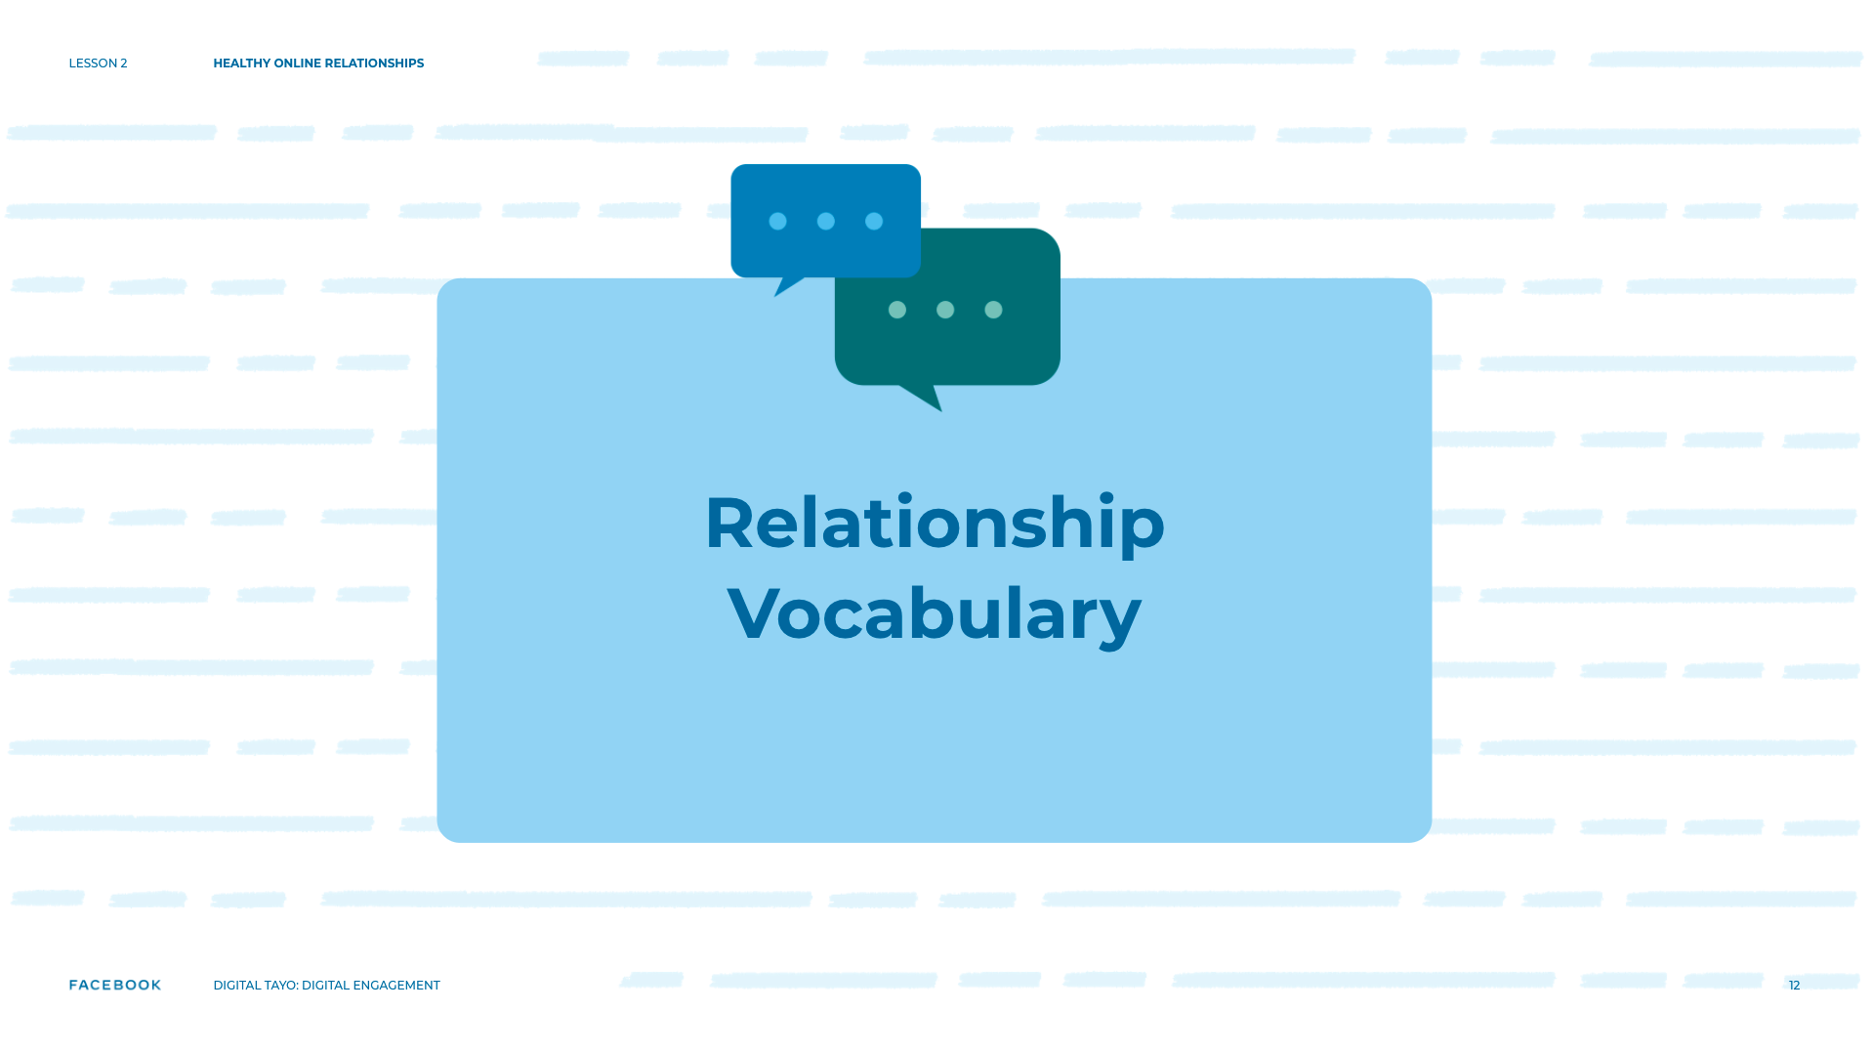
Notes:
Speaker Notes:
Relationship Vocabulary
Part 1
CLASS INTERACTION
Gather students into a circle.
TELL YOUR STUDENTS
Today, I want to talk about how what we do online has an impact on the health of our relationships. We’ll also talk about what you can do to be an “upstander” for others and recognize when our friends need help with some of their problems in relationships.

Slide 13
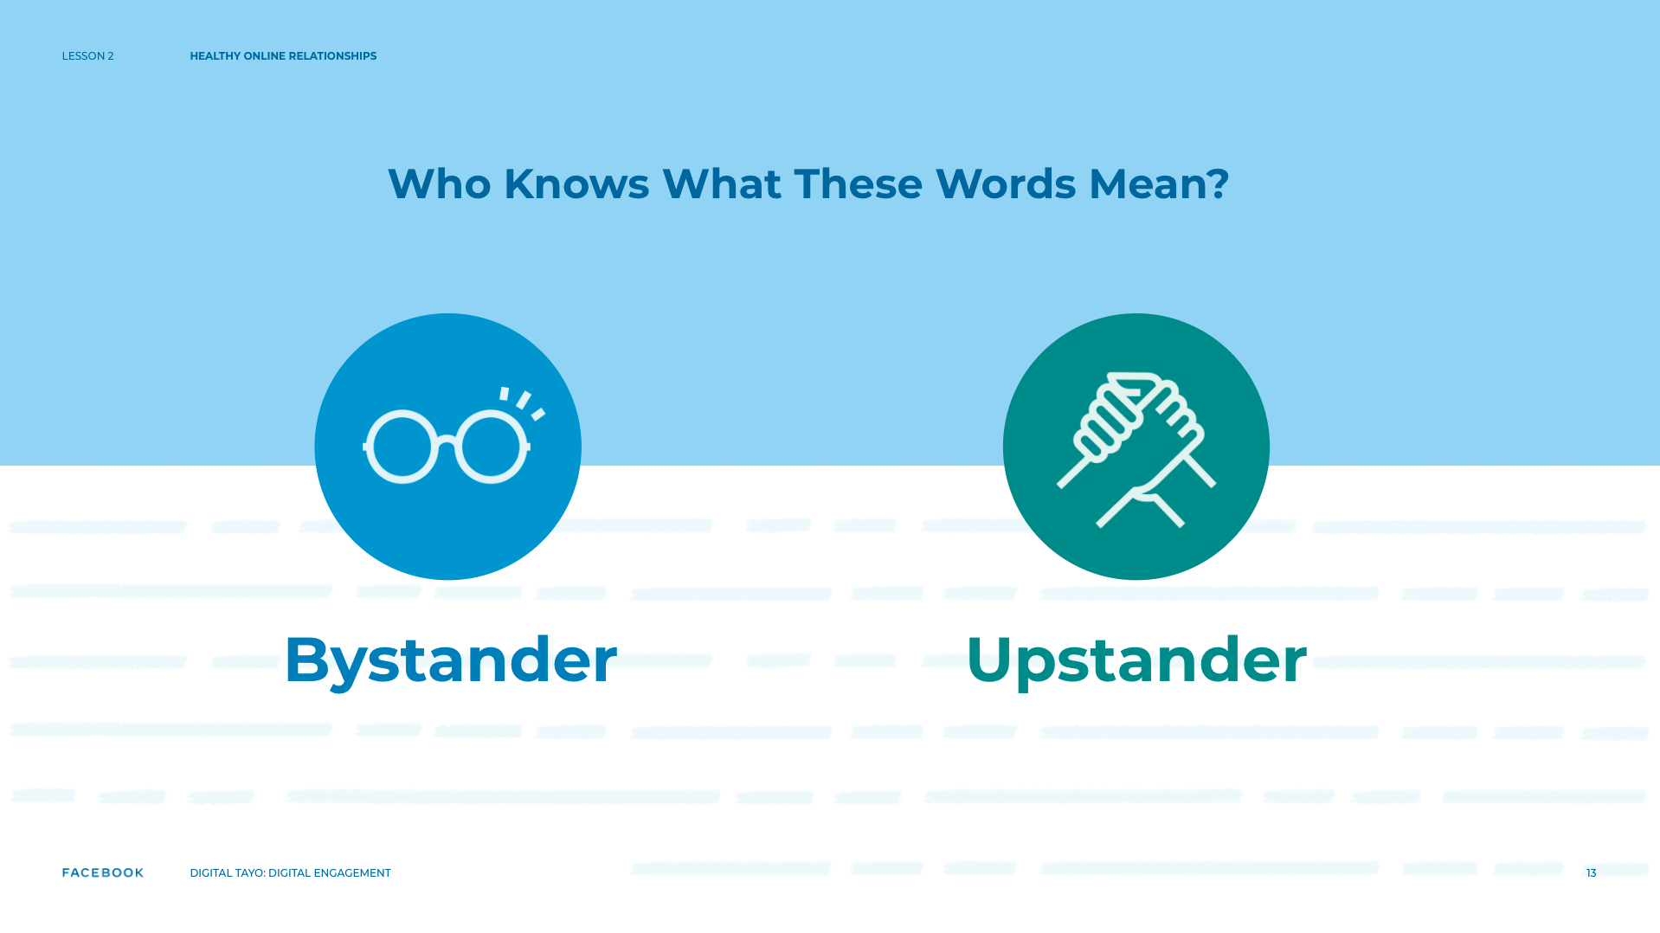
Notes:
Speaker Notes:
ASK YOUR STUDENTS
Who’s heard of the words “bystander” or “upstander”? What do these words mean to you?
CLASS INTERACTION
Listen to two or three responses.

Slide 14
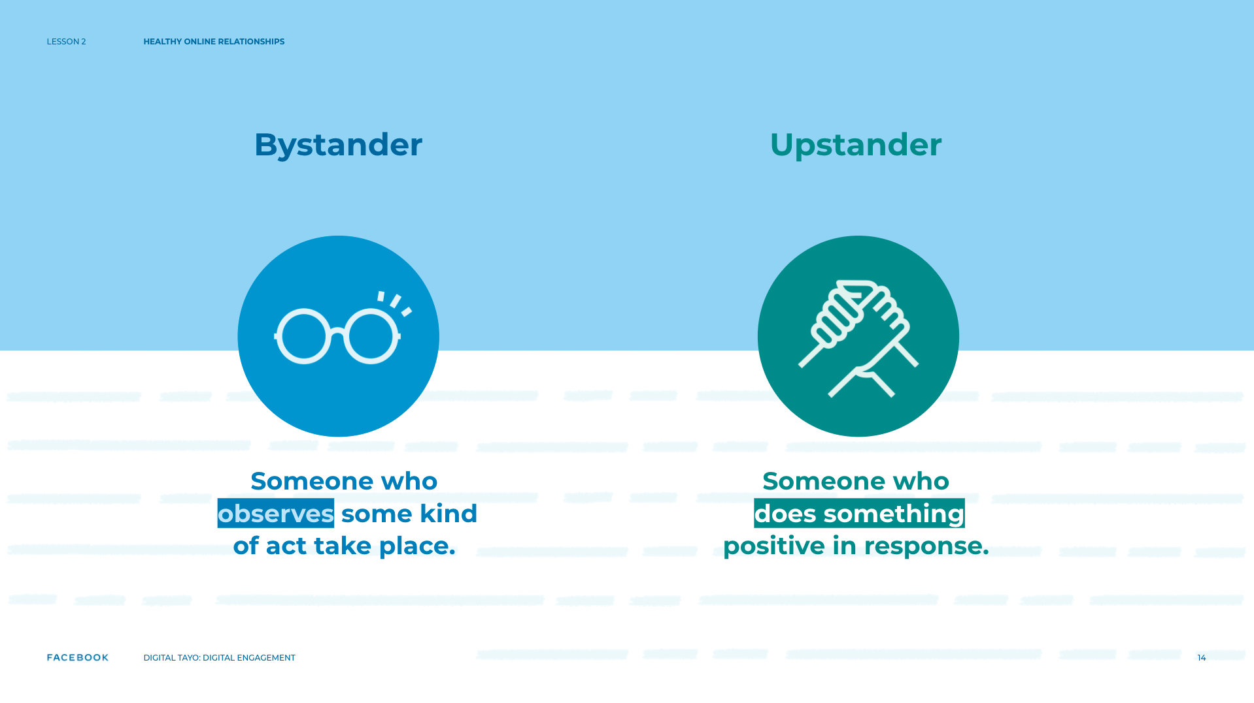
Notes:
Speaker Notes:
TELL YOUR STUDENTS
As you suggested, a bystander is someone who observes some kind of act take place. For today’s exercise, we’re talking about acts related to unhealthy/unkind relationships. An upstander is someone who does something positive in response — maybe by supporting the victim, helping to stop the act or in other ways, depending on the situation.

Slide 15
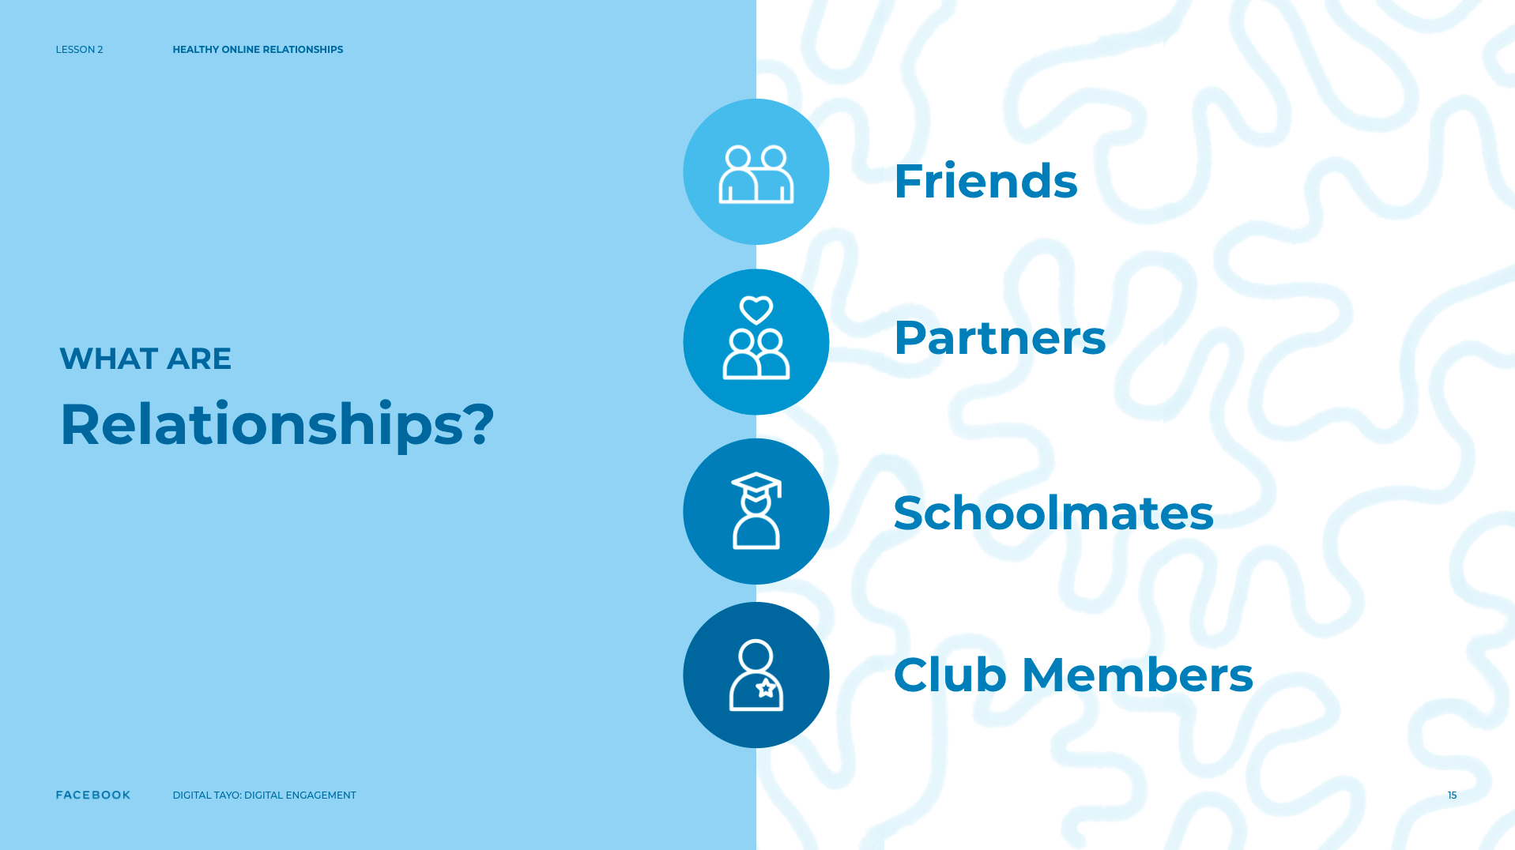
Notes:
Speaker Notes:
Part 2
TELL YOUR STUDENTS
Now let’s talk about relationships. First, we should recognize that “relationships” is a pretty broad term. For our purposes, we’re going to define “relationship” to mean any connection between peers. For example, you may be connected to your peers through friends, romantic relationships, schoolmates, or as members of the same out-of-school activity (e.g., film club). Whenever we talk about healthy relationships, a tough question always comes up: “What exactly is a healthy relationship?” Everyone has different ideas about this topic and there are a lot of good answers.
To make sure we’re all on the same page, let’s think out loud about words that can describe healthy relationships — friendships, schoolmates, a variety of relationships! We know that sometimes things can go wrong in all kinds of relationships, so let’s talk about healthy behaviors unique to various types.

Slide 16
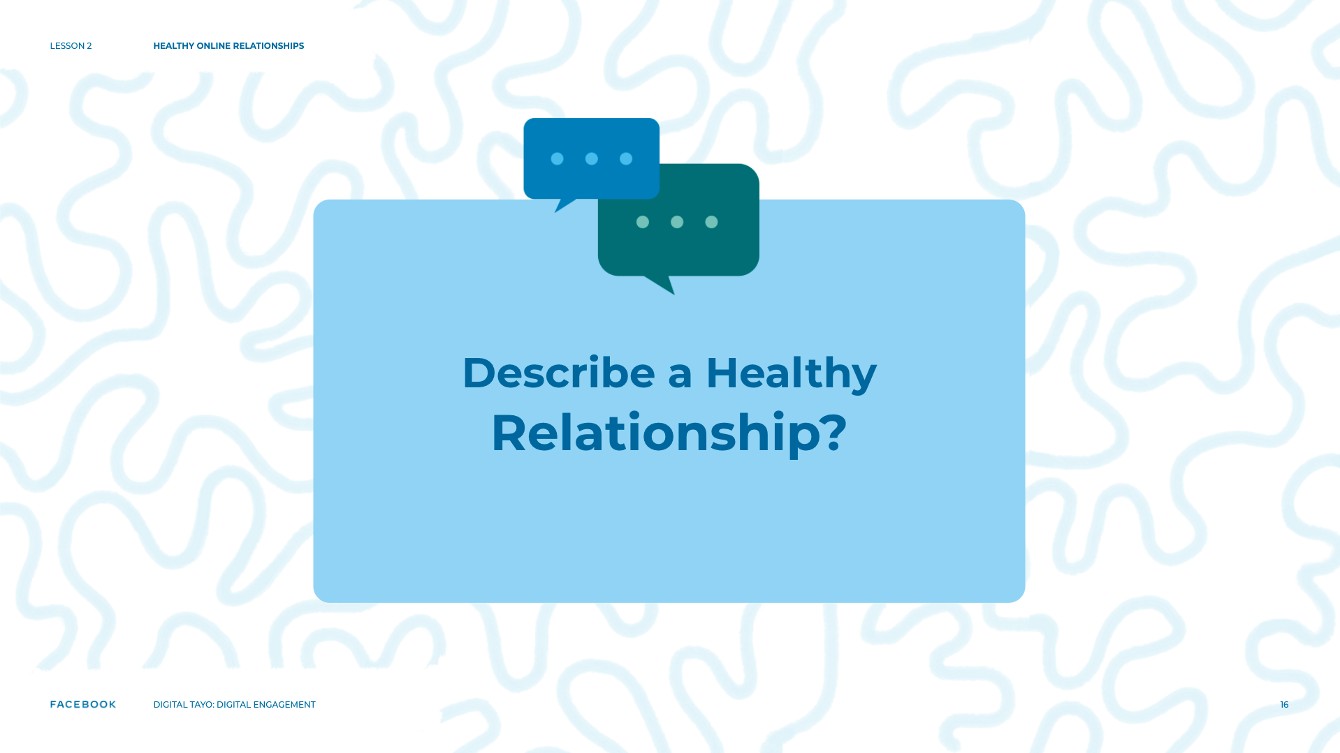
Notes:
Speaker Notes:
Optional:
TELL YOUR STUDENTS:
Let’s play a small game. As we go around in a circle, let’s each say one word that describes healthy relationships. I’ll start. I think relationships can be (supportive, caring, kind, etc.).

Slide 17
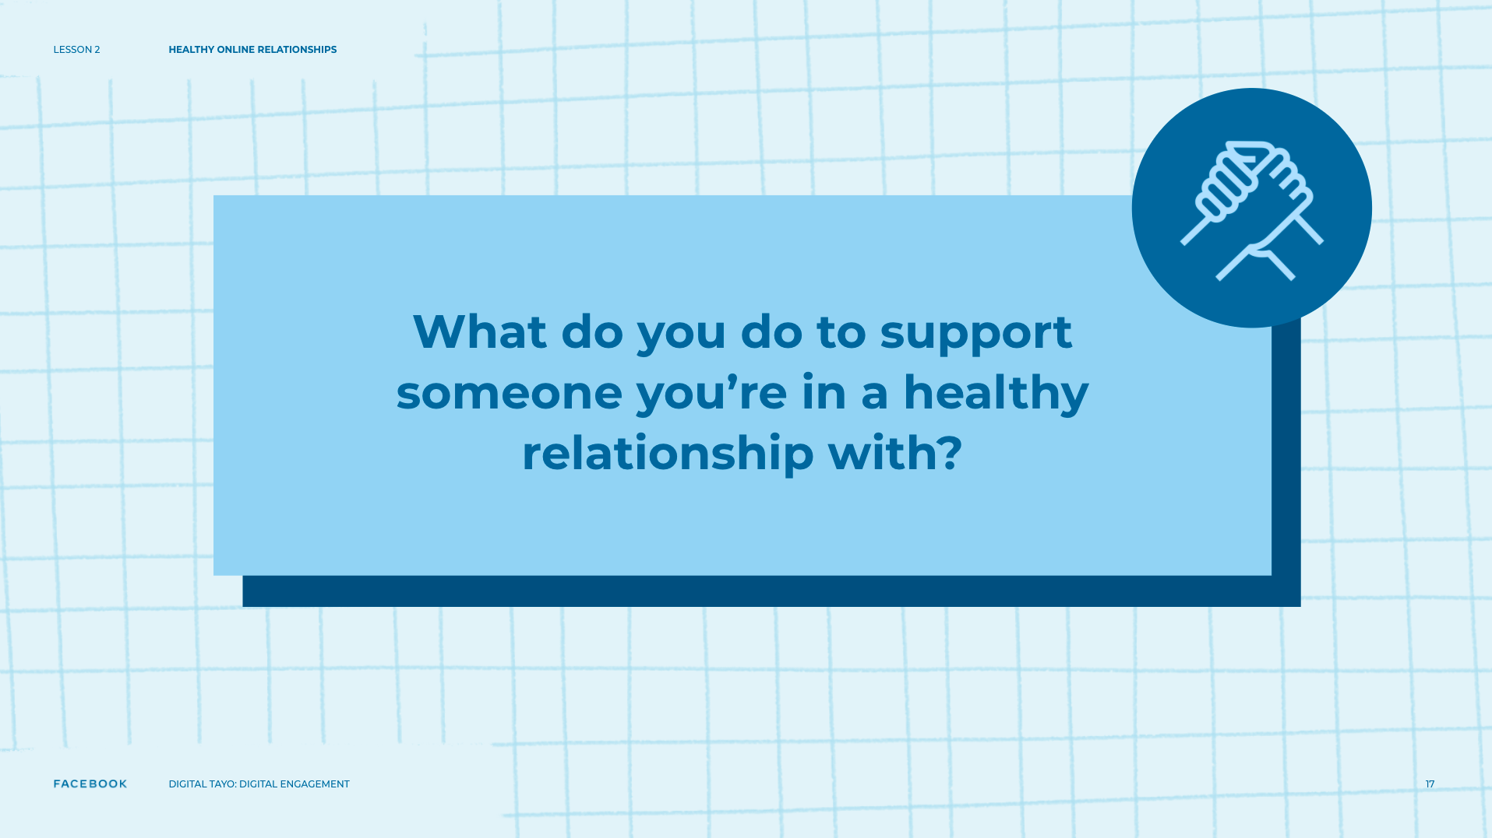
Notes:
Speaker Notes:
ASK YOUR STUDENTS
What do you do to support someone you're in a healthy relationship with?
OPTIONAL CLASS INTERACTION
Write down what students say on the flipchart.
TELL YOUR STUDENTS
Great! Thanks for contributing! Let’s take a look at these words.
ASK YOUR STUDENTS
Do we agree with them?
Do you have anything extra to add?
Based on these words, can someone come up with a one-sentence definition of a healthy relationship?
GOAL
Guide the group in developing a shared definition of a healthy relationship.

Slide 18
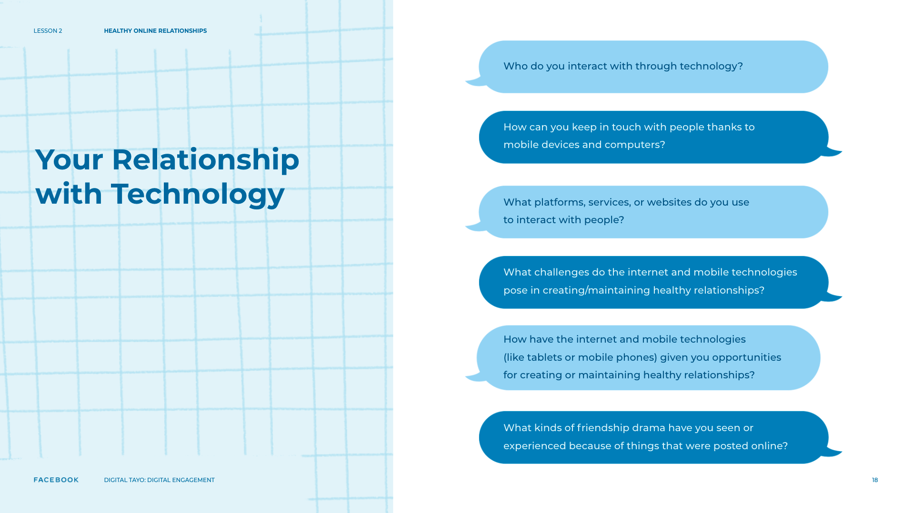
Notes:
Speaker Notes:
Gallery Walk
CLASS INTERACTION
Divide students into pairs.
TELL YOUR STUDENTS
Now that we have a pretty good list of the things we think about when we talk about “healthy relationships,” it’s time to switch our focus a bit and take a look at our own experiences with relationships on the internet.
CLASS INTERACTION
Write one question from the possible list below on a poster and affix posters around the room.
Possible Poster Questions:
Who do you interact with through technology?
What platforms, services, or websites do you use to interact with people?
How have the internet and mobile technologies (like tablets or mobile phones) given you opportunities for creating or maintaining healthy relationships?
How can you keep in touch with people thanks to mobile devices and computers?
What challenges do the internet and mobile technologies pose in creating/maintaining healthy relationships?
What kinds of friendship drama have you seen or experienced because of things that were posted online?
TELL YOUR STUDENTS
I’m going to give each pair some sticky notes and a pen. On the posters around the room are different questions. When I give you your materials, you can move around to the posters. Write your answers down on the sticky notes and put them on the posters. If you have more than one answer to a question, write down each answer on a separate sticky and put them onto the posters. You’ll have eight minutes. In order to get to all the posters, spend 1-2 minutes per poster. Have fun!
CLASS INTERACTION
Collect posters at the end of the activity and gather the group together again.
ASK YOUR STUDENTS
What are common answers to each of these questions?
Are there any things that you think are missing?
Are there trends that you notice?
How has technology changed your relationships with your friends?
Has technology made things easier or more difficult? Why?

Slide 19

Notes:
Speaker Notes:
Scenario Discussion
TELL YOUR STUDENTS
Now we’re going to discuss a scenario connected to technology and relationships called “over-messaging.” Does anyone know what “over-messaging” is?
CLASS INTERACTION
Listen to two or three responses.

Slide 20
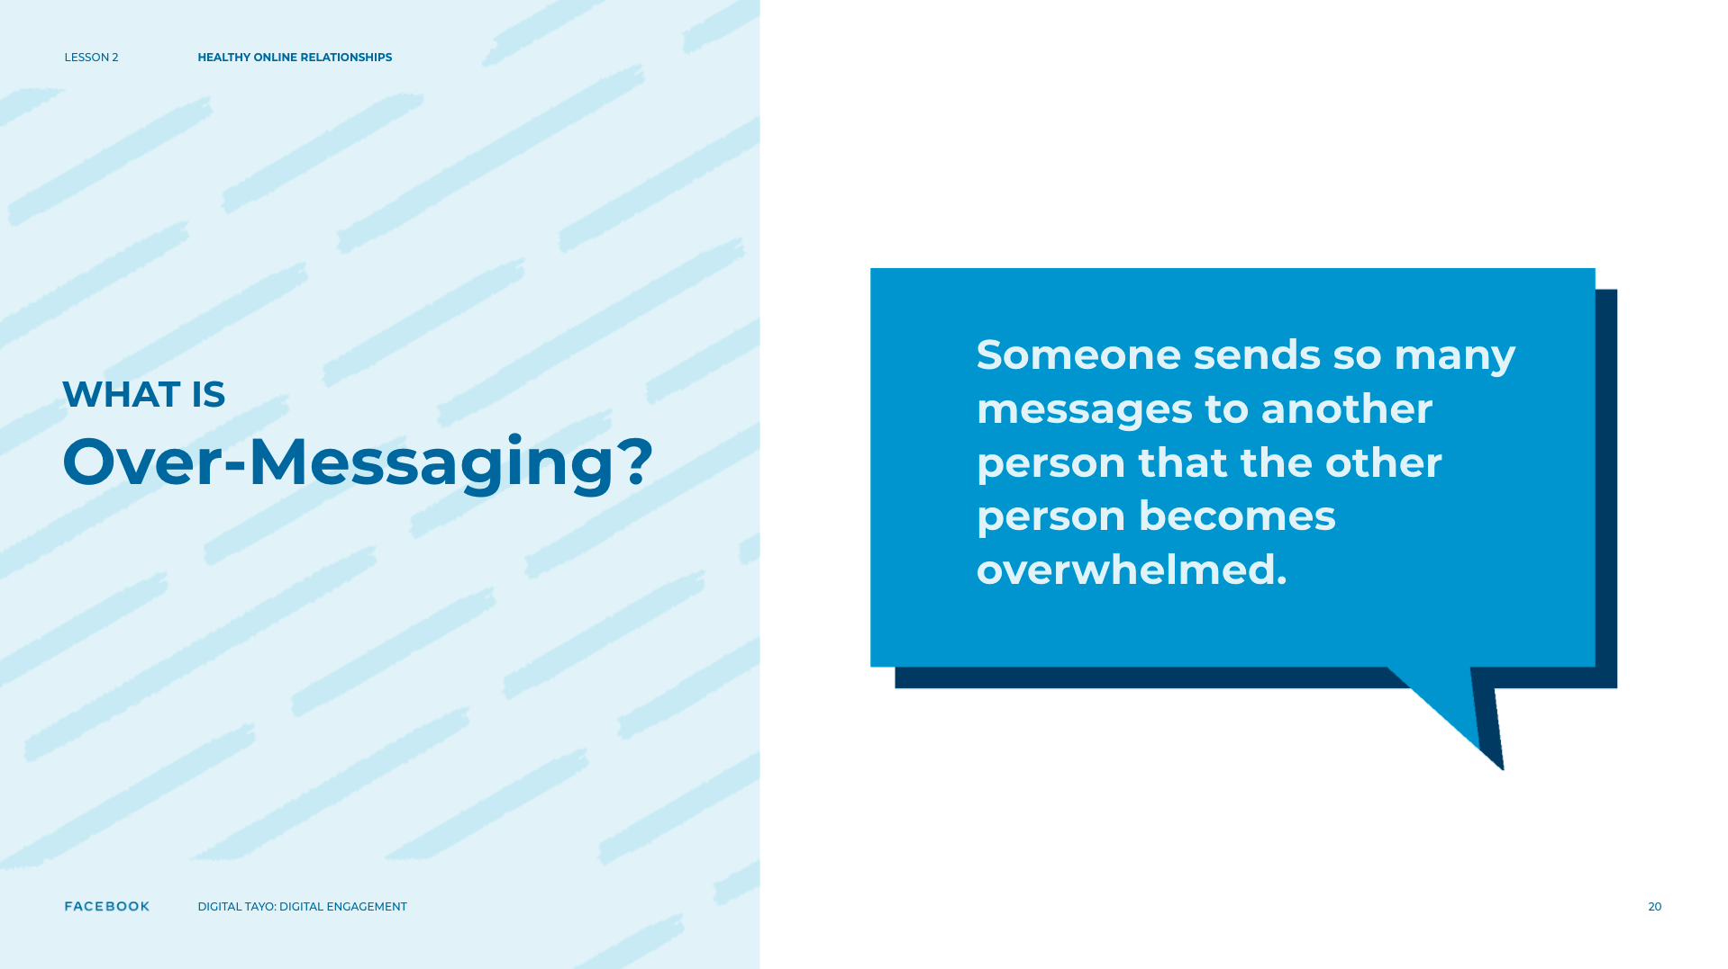
Notes:
Speaker Notes:
TELL YOUR STUDENTS
Over-messaging is when someone sends so many messages to another person that the other person becomes overwhelmed.
ASK YOUR STUDENTS
Has anyone ever experienced over-messaging?
If you were the person receiving the messages, what would you do? Why?
If one of your friends approached you and said that he or she was facing this situation, what advice would you give? Would you take action? What different types of actions could you take?
Follow-up: Taking these actions to help your friends is also called “upstanding.”
ASK YOUR STUDENTS
What might stop someone from standing up for a friend?
Let’s pretend that one of your friends asks a friend to stop messaging so much. What happens if the friend starts coming to the person’s house all the time, constantly asking to see him or her? The problem seems to be getting worse, which can be termed “escalation.” What advice would you give to your friend if the problem escalates?
If the problem does escalate, can you still respond as an upstander in the same way as before? What actions could you now take to be an upstander?

Slide 21
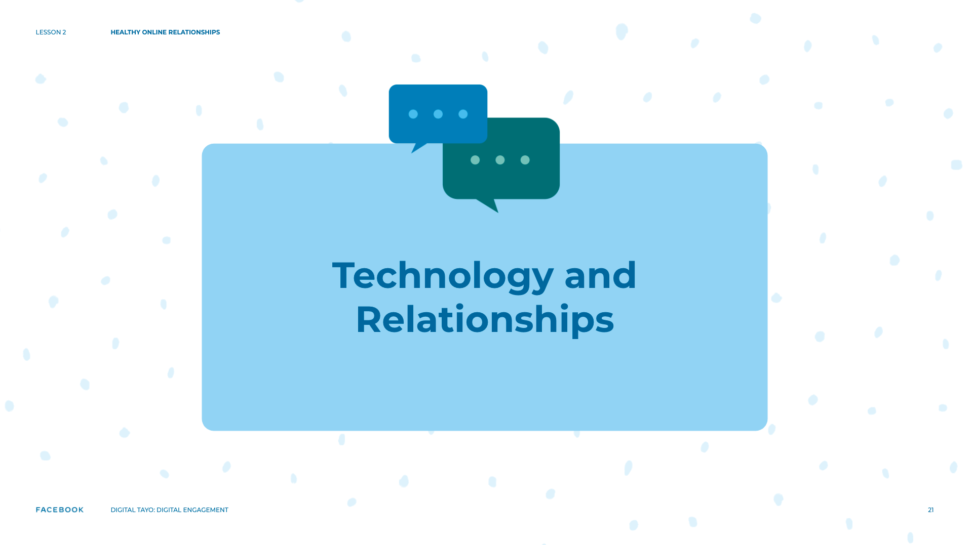
Notes:
Speaker Notes:
TELL YOUR STUDENTS
“Over-messaging” is only one example of a situation where technology can get in the way of a healthy relationship.
ASK YOUR STUDENTS
What are other examples?
What are some solutions to these problems?
What has our discussion so far told us about the role of technology in relationships?

Slide 22
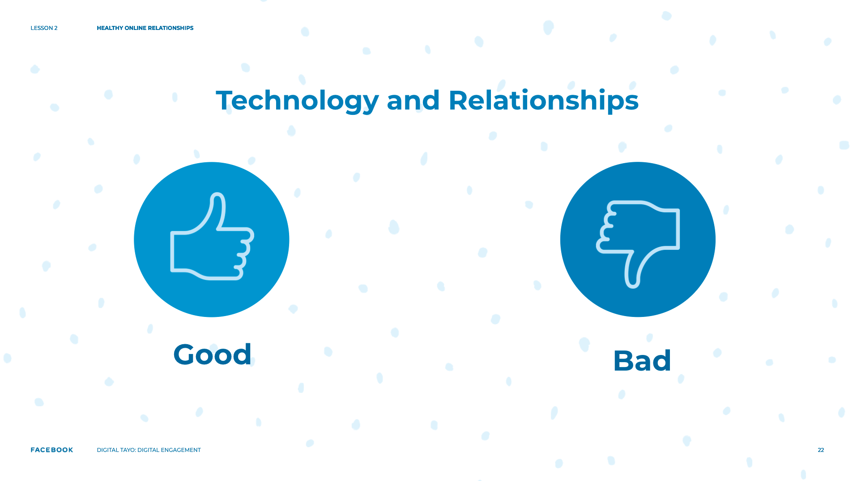
Notes:
Speaker Notes:
CLASS INTERACTION
Guide a discussion about the positive and negative impacts of technology on relationships.

Slide 23

Notes:
Speaker Notes:
Spectrum Activity
TELL YOUR STUDENTS
Let’s take a look at specific behaviors in healthy and unhealthy relationships and where they fall on a spectrum from healthy to unhealthy. I am going to hand each of you one sticky note. On the sticky note is an activity that happens in relationships, like “messaging your partner 24/7” or “exchanging social media passwords.” Once I give you a sticky note, I’d like you to stand up and move to the front of the room. On one side of the room is the healthiest relationship behavior (labeled “1”) and on the other side is the unhealthiest relationship behavior (labeled “10”).

Slide 24
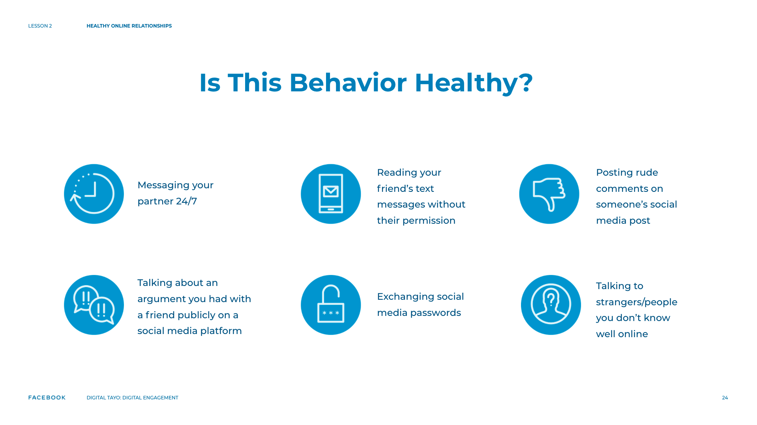
Notes:
Speaker Notes:
TELL YOUR STUDENTS
When you come up, think about how healthy or unhealthy the behavior on the card is and stand in a line of how you would rank the behavior from 1 to 10. For example, if you believe that “messaging your partner 24/7” is less healthy than “liking and re-sharing everything your friends post,” then stand closer to the “10” or unhealthy side.
CLASS INTERACTION
Suggested card topics:
Messaging your partner 24/7
Exchanging social media passwords
Reading your friend’s text messages without their permission
Talking to strangers/people you don’t know well online
Posting rude comments on someone’s social media post
Messaging “good night” or “good morning” (maybe every day) to someone you care about
Talking about an argument you had with a friend publicly on a social media platform
Liking and re-sharing everything your friends post
Posting content on social media using your friend’s account (in their name)
Tagging your friends in photos from a party
Spreading gossip about your schoolmate on social media
Posting excerpts from a private conversation without asking permission
As students come up and organize themselves, ask them about why they are standing where they are and encourage students to move around if they feel the need. Once students have arranged themselves into a spectrum, ask them to place the sticky notes on the wall in the front of the room and take a step back so that they can see the spectrum in its entirety.
CLASS INTERACTION
If they choose to do so, students can answer the first two questions below through a discussion, versus writing them down on sticky notes and placing them on the wall in the front of the room.
ASK YOUR STUDENTS
Are there any other unhealthy behaviors you can think of? Are there any other healthy behaviors you can think of?
Is there only one correct order for this spectrum? Why/why not? Do you all agree?
We put these specific behaviors on a spectrum from healthy to unhealthy. But, might there be situations when a healthy behavior turns unhealthy? Or vice versa? When might that happen?
If X is an unhealthy behavior (choose a specific behavior that students affixed closer to the ”‘unhealthy” side of the spectrum), what would you do to resolve it?
How would you talk to someone if you were not okay with what they were doing?

Slide 25
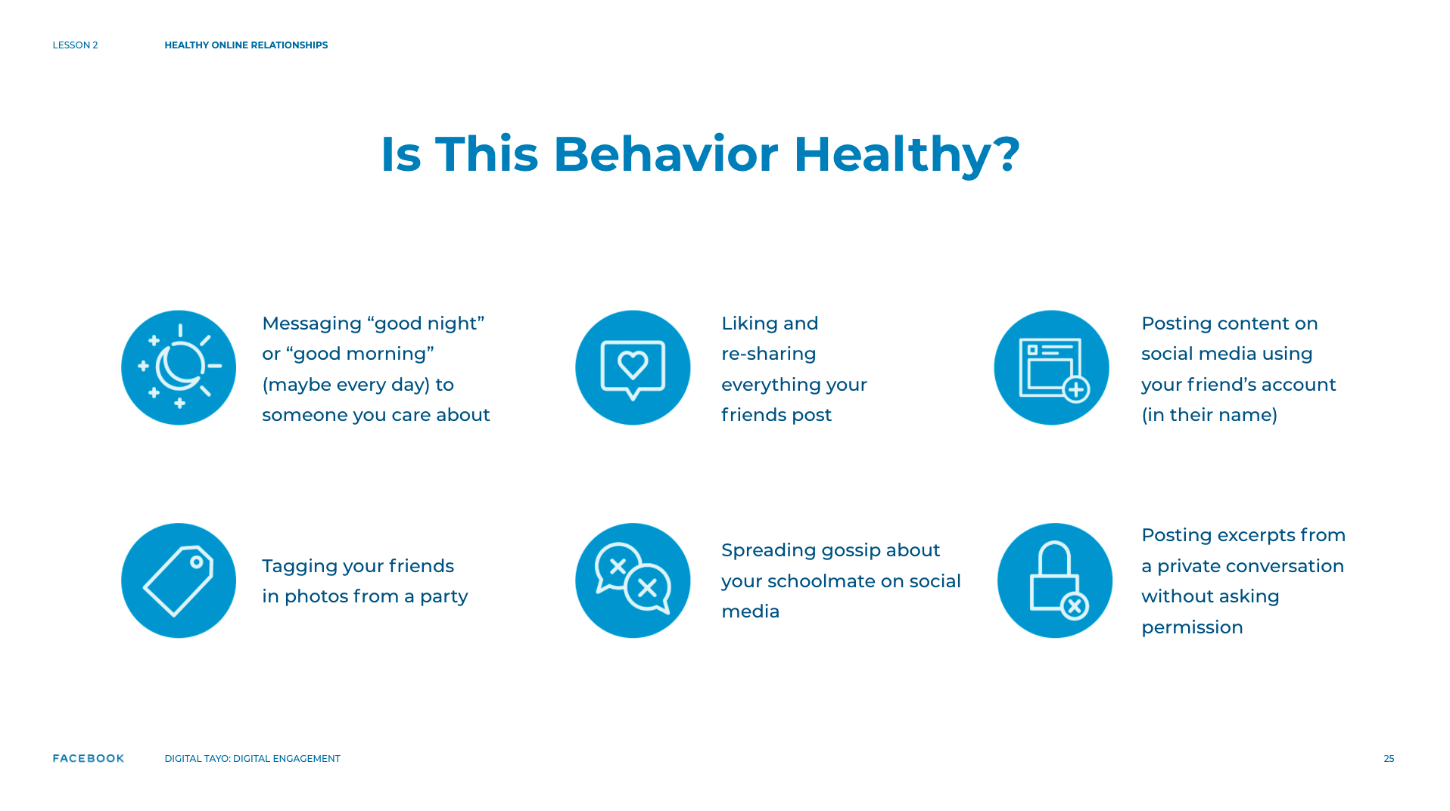
Notes:
Speaker Notes:
When you come up, think about how healthy or unhealthy the behavior on the card is and stand in a line of how you would rank the behavior from 1 to 10. For example, if you believe that “messaging your partner 24/7” is less healthy than “liking and re-sharing everything your friends post,” then stand closer to the “10” or unhealthy side.
CLASS INTERACTION
Suggested card topics:
Messaging your partner 24/7
Exchanging social media passwords
Reading your friend’s text messages without their permission
Talking to strangers/people you don’t know well online
Posting rude comments on someone’s social media post
Messaging “good night” or “good morning” (maybe every day) to someone you care about
Talking about an argument you had with a friend publicly on a social media platform
Liking and re-sharing everything your friends post
Posting content on social media using your friend’s account (in their name)
Tagging your friends in photos from a party
Spreading gossip about your schoolmate on social media
Posting excerpts from a private conversation without asking permission
As students come up and organize themselves, ask them about why they are standing where they are and encourage students to move around if they feel the need. Once students have arranged themselves into a spectrum, ask them to place the sticky notes on the wall in the front of the room and take a step back so that they can see the spectrum in its entirety.
CLASS INTERACTION
If they choose to do so, students can answer the first two questions below through a discussion, versus writing them down on sticky notes and placing them on the wall in the front of the room.
ASK YOUR STUDENTS
Are there any other unhealthy behaviors you can think of? Are there any other healthy behaviors you can think of?
Is there only one correct order for this spectrum? Why/why not? Do you all agree?
We put these specific behaviors on a spectrum from healthy to unhealthy. But, might there be situations when a healthy behavior turns unhealthy? Or vice versa? When might that happen?
If X is an unhealthy behavior (choose a specific behavior that students affixed closer to the ”‘unhealthy” side of the spectrum), what would you do to resolve it?
How would you talk to someone if you were not okay with what they were doing?

Slide 26
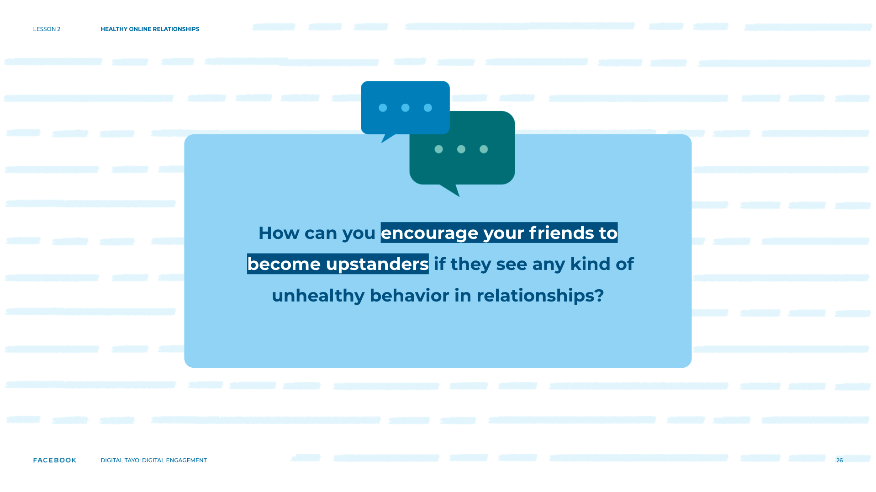
Notes:
Speaker Notes:
ASSIGNMENT
Part 1
TELL YOUR STUDENTS
We’ve talked a lot today about technology and relationships. Now that we’ve got you thinking, how can you share what you’ve learned with others? What kind of activities can you create to encourage your peers to become upstanders if they witness any kind of unhealthy behavior in relationships?
ASSIGNMENT
Split students into groups of three or four.
TELL YOUR STUDENTS
We have two suggestions right now, but if you’ve got a different idea, go ahead and do it! You have 30 minutes.

Slide 27
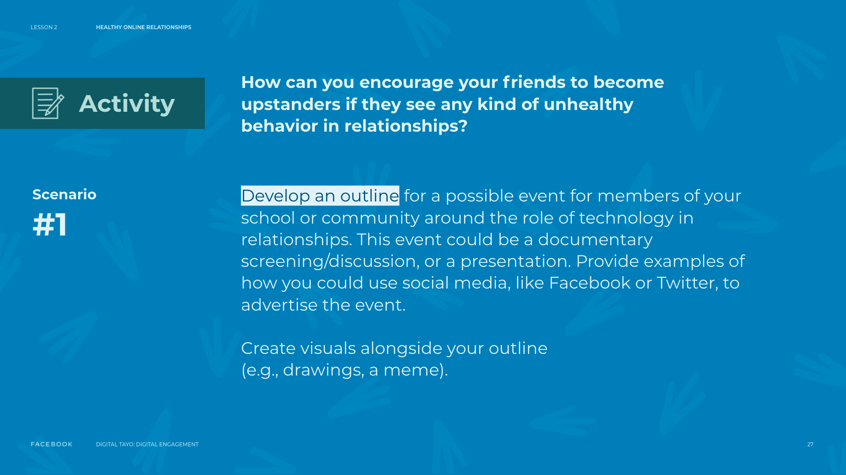
Notes:
Speaker Notes:
Suggestion #1: Develop an outline for a possible event for members of your school or community around the role of technology in relationships. This event could be a documentary screening/discussion, or a presentation. Provide examples of how you could use social media, like Facebook or Twitter, to advertise the event. Feel free to create visuals alongside your outline (e.g., drawings, a meme).

Slide 28
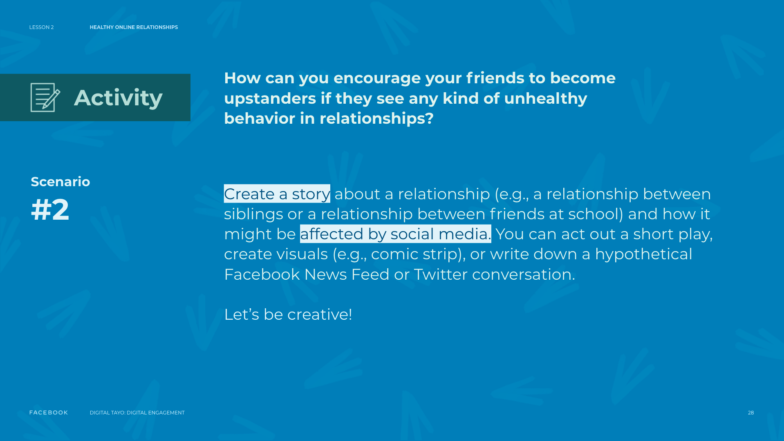
Notes:
Speaker Notes:
Suggestion #2: Create a story about a relationship (e.g., a relationship between siblings or a relationship between friends at school) and how it might be affected by social media. You can act out a short play, create visuals (e.g., comic strip), or write down a hypothetical Facebook News Feed or Twitter conversation. Let’s be creative!

Slide 29
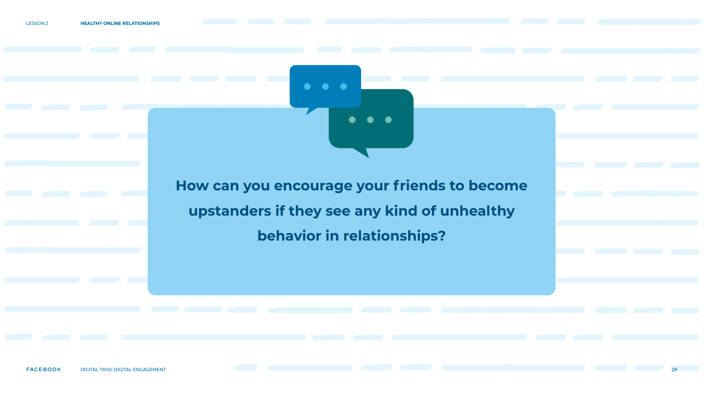
Notes:
Speaker Notes:
Part 2
ASSIGNMENT
After the 30 minutes are up, ask groups to share what they’ve created and engage them in the discussion questions below.
ASK YOUR STUDENTS
What topic are you addressing?
What do you want people to learn from your idea? How will this idea benefit your school/community/friends?
Who is the target audience?
How will you advertise your idea to your target audience?
How do you think your audience will react?

Slide 30
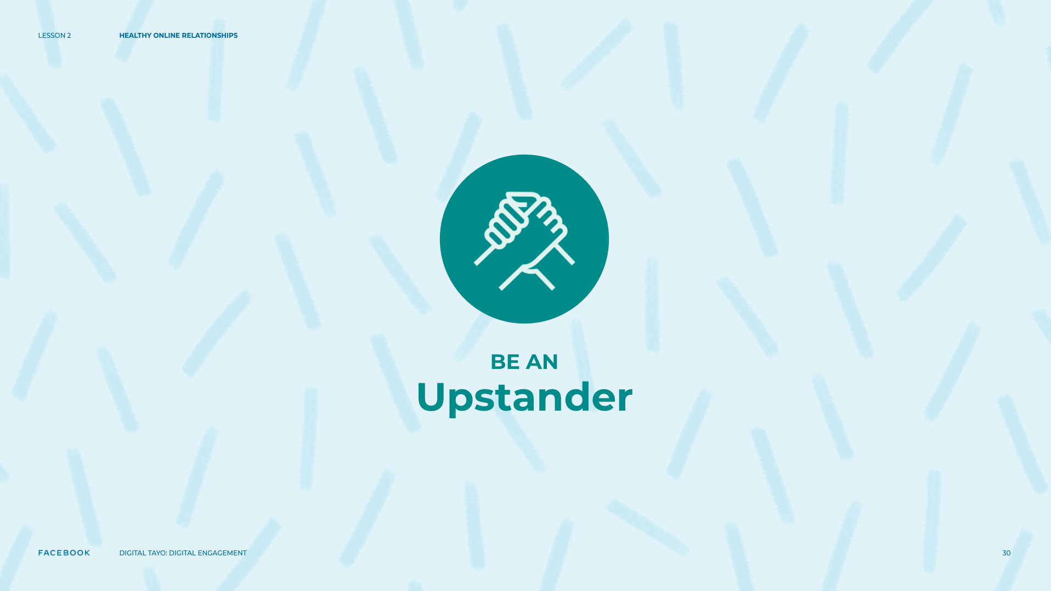
Notes:
Speaker Notes:
Closing Reflection
TELL YOUR STUDENTS
We hope that you’ve all thought about healthy relationships a little more deeply, especially in terms of how technology has changed things. We also wanted you to think about ways to encourage your friends to “upstand,” or to stand up for themselves and others when they see something they are uncomfortable with or something that hurts others.
ASK YOUR STUDENTS
What were some of the things you learned?
What was your favorite activity? Why?
What was your least favorite activity? Why?
How can you take what you learned or worked and apply it to your life? How would you describe what you did to your friends?
What was something new or surprising?
Do you have any other questions about healthy or unhealthy relationships?

Slide 31
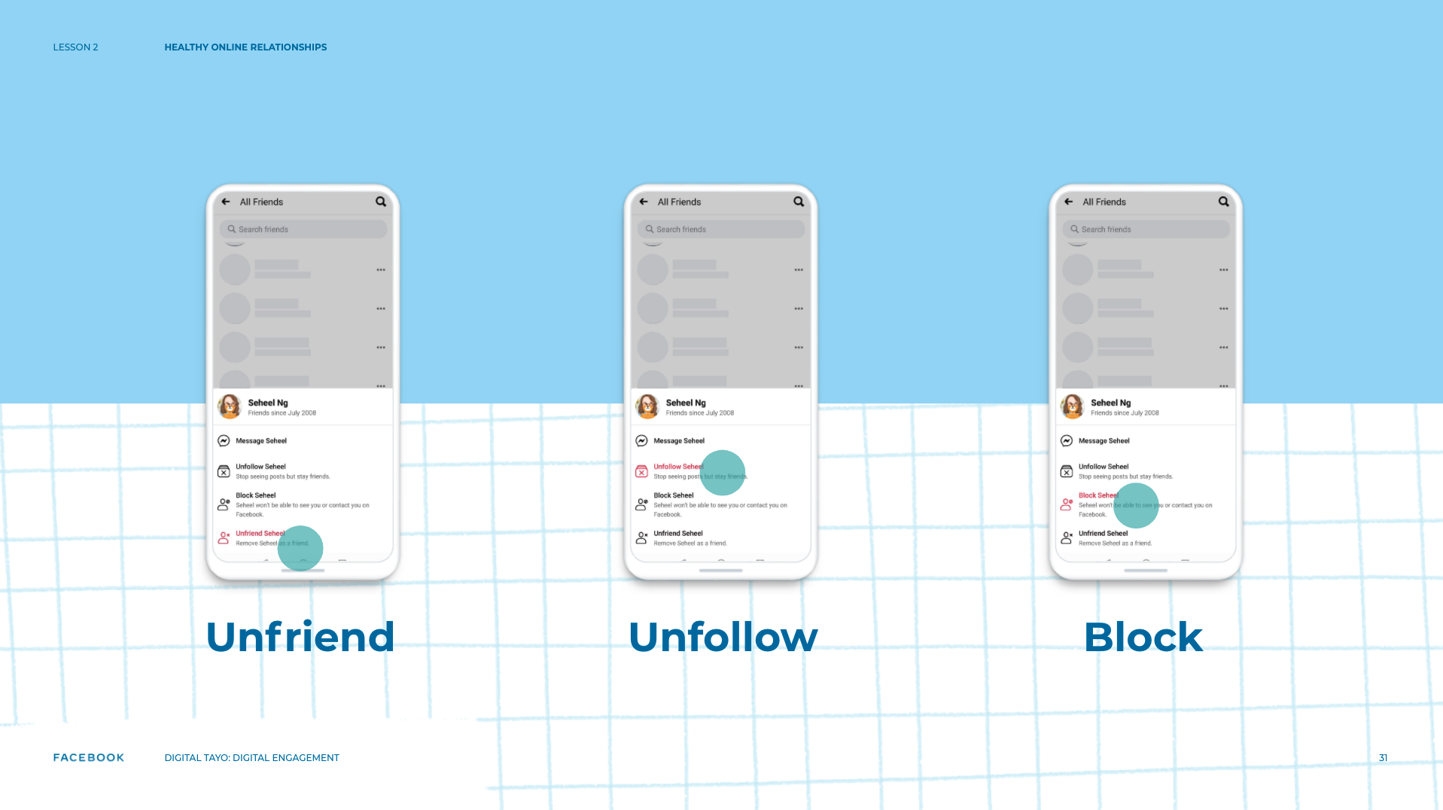
Notes:
Speaker’s Notes
TELL YOUR STUDENTS
Facebook is a place for you to connect with the people and things you care about.
You are in control of whom you accept as a “Friend” on Facebook.
Before accepting someone as a “Friend” you might want to take a look at the person’s profile.
Do you have friends in common? Are you from the same town?
Do you know them well enough that you feel comfortable accepting their friend request?
It's your choice — you can confirm or deny friend requests.
Unfriending: To unfriend someone, go to that person's profile, hover over the Friends button at the top of their profile, and select ‘Unfriend’.
If you choose to unfriend someone, Facebook will not notify the person but you'll be removed from that person's friend list. If you want to be friends with this person again, you'll need to send a new friend request.
To learn more about removing friends, visit fb.me/Unfriending
Unfollowing: When you unfollow someone, you won't see their posts in your News Feed, but you'll still be friends with them.
To unfollow a person, Page, or group directly, hover over ‘Following’ (on a profile), ‘Liked’ (on a Page), or ‘Joined’ (in a group) near their cover photo and select ‘Unfollow’.
Blocking: Facebook also enables anyone to block other people.
Blocking a person automatically unfriends them so you no longer see them or their content.
They also can no longer see things you post on your profile, tag you, invite you to events or groups, start a conversation with you, or add you as a friend.
Blocking is reciprocal so you also won't be able to do things like start a conversation with them or add them as a friend.
When you block someone, we do not notify them that you have blocked them. To block someone:
Click at the top right of any Facebook page.
Click How do I stop someone from bothering me?
Enter the name or email address of the person you want to block and click Block.
If you entered a name, select the specific person you want to block from the list that appears.
To learn more, visit fb.me/Blocking

Slide 32
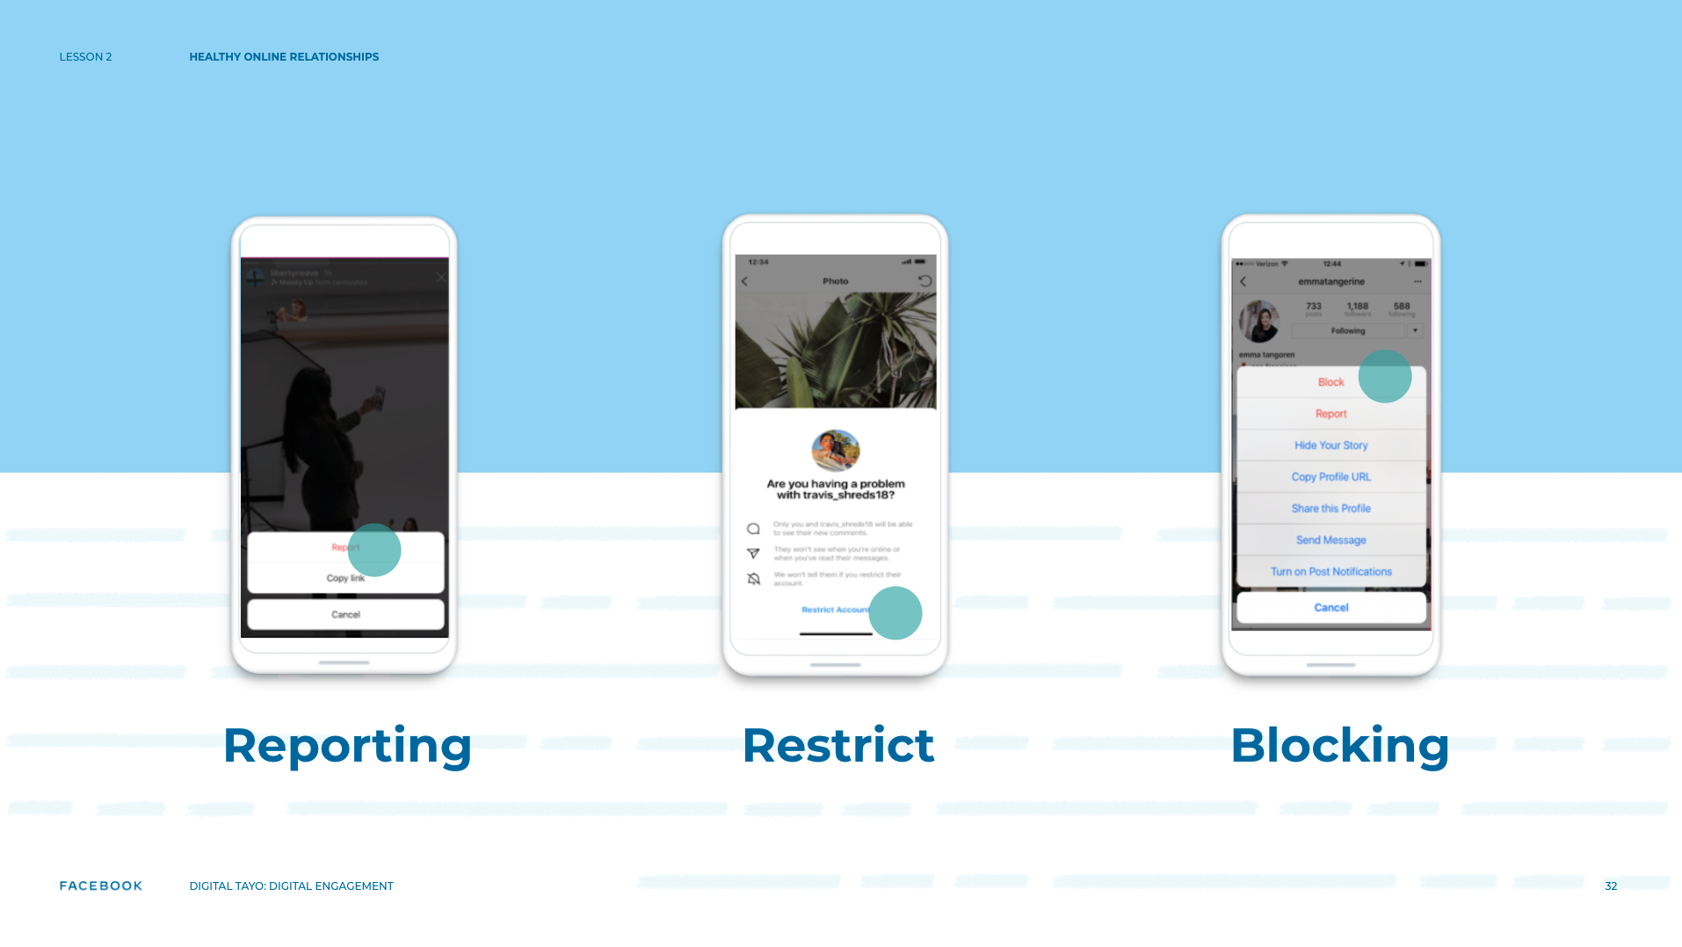
Notes:
Speaker’s Notes
TELL YOUR STUDENTS
For those of you who are Instagram users there are some easy ways to report, restrict, and block users in Instagram. You can report content, comments, or accounts.
What happens when you report?
There is a global team that reviews the reports and works as quickly as possible to remove content that doesn’t meet the Guidelines.
In addition to in-app reporting, Instagram has further Help Center resources to help you report:
Impersonation Account
Underage Child’s Account
Hate Account
Hacked Account
Intellectual Property Violations
Instagram also has reporting within the app, across the platform. If you see something that you think doesn't belong on Instagram, you can report it, restrict it, or block it. If the reported content breaks the rules, it is taken down.
One report is enough to take down content that breaks the rules. Multiple reports of something that doesn't break the rules won't lead to its removal.
Restrict: Restrict is designed to empower you to protect your account quietly while still keeping an eye on an account that has contributed to a negative experience for you. Sometimes, due to negative engagement, or whatever your reason may be, a greater degree of separation is desired between accounts.
Blocking: Blocking an account means they won’t see your content and you won't see their comments on other people's posts.

Slide 33
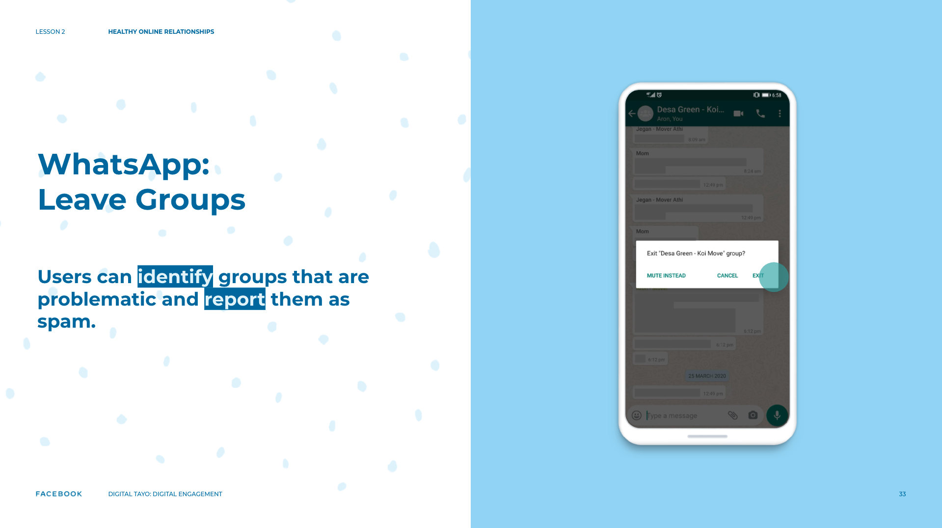
Notes:
Speaker’s Notes
TELL YOUR STUDENTS
On WhatsApp you can block any number or leave any group you want. Use these features to keep control of your WhatsApp experience.
So much like Facebook and Instagram you can report spam groups that you feel are a problem or Leave a Group.
ASK YOUR STUDENTS
Have you been added to groups you don’t necessarily want to be a part of?
TELL YOUR STUDENTS
You can also mute/leave the group instantly.
Either way it’s your choice whether you Mute or Leave.

Slide 34
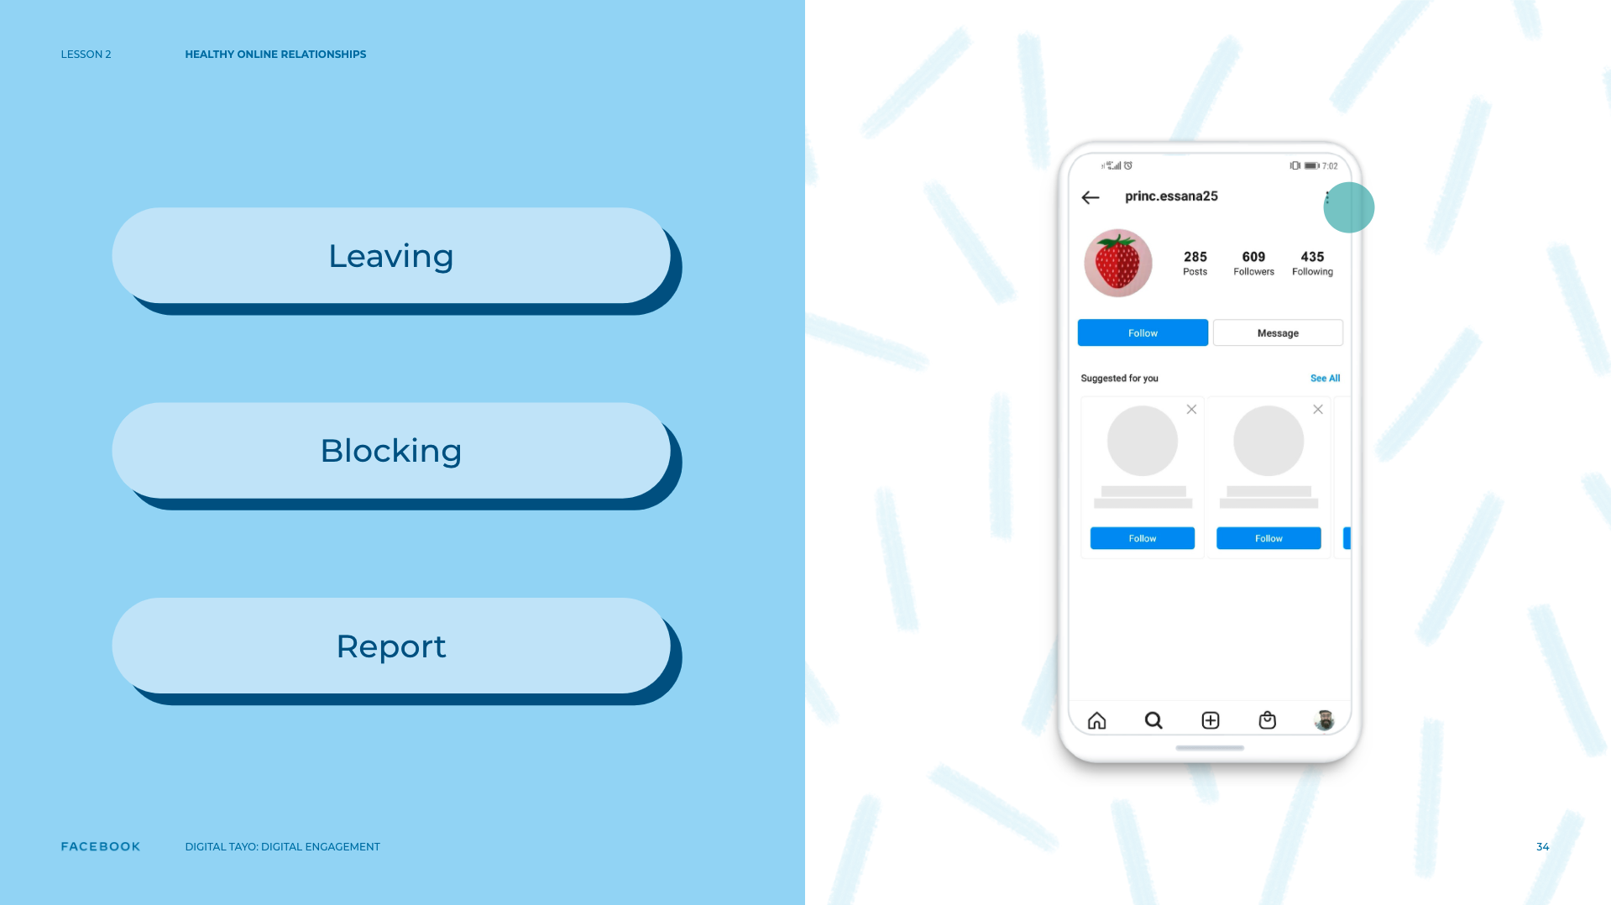
Notes:
Speaker’s Notes
TELL YOUR STUDENTS
So remember, whether you are on Facebook, Instagram, WhatsApp, or Messenger you can block or report content or people that are sharing information you don’t think is appropriate
Whether it is because of harassment, bullying, or other issues, nearly every piece of content can be reported or blocked.
When something gets reported to the Facebook company it is reviewed and either the content or the person is removed if it violates the Community Standards facebook.com/communitystandards.
In all cases the person who reported or blocked the offender isn’t shared.
The extended Facebook teams work in offices around the world, 24 hours a day, 7 days a week, in over two dozen languages to review things you report to make sure Facebook Instagram, WhatsApp, and Messenger remain safe.
The best way to report abusive content or spam is by using the Report link that appears near the content itself.
For instance, to report a post:
Click in the top right of the post you want to report and select I don't want to see this.
Click Why don't you want to see this?
Choose the option that best describes the issue and follow the on-screen instructions.
If you've reported something, you have the option to check the status of your report from the Support Inbox.
Please keep in mind that only you can see your Support Inbox: fb.me/supportInbox
To learn more, visit: fb.me/Reporting
RESOURCE
Stairway Foundation’s CyberSafety e-learning course: “Some Things are Not Worth Sharing” - https://bit.ly/CyberSafeELearningNewLink

Slide 35
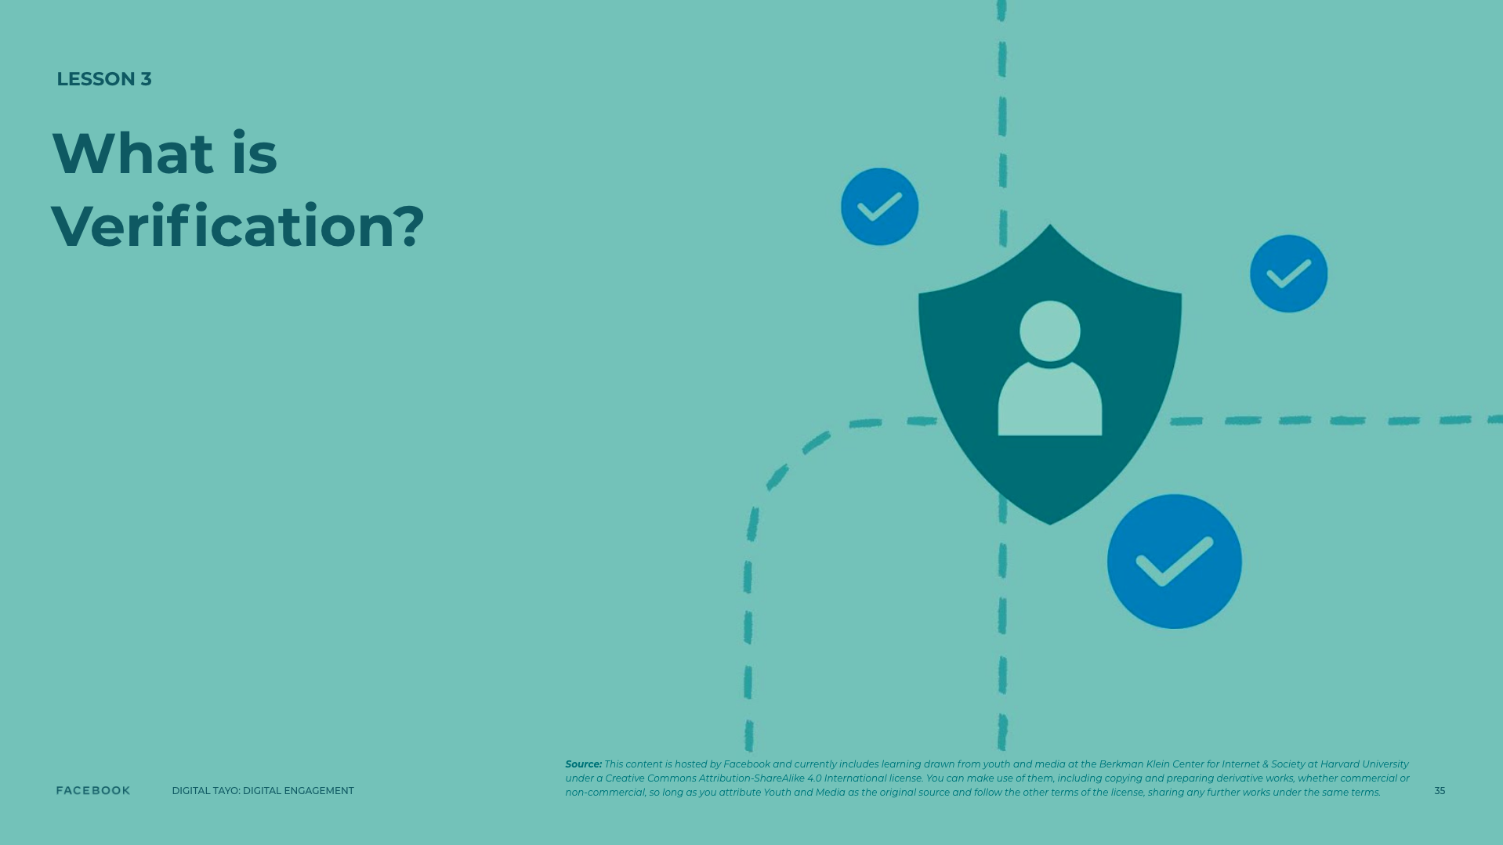
Notes:
Speaker Notes:
LESSON OBJECTIVE
Students will learn what information verification is and why it is important for news consumers to verify the stories they read or view. They will consider the responsibilities news organizations, audience members, and social media companies have in promoting a media landscape of truthful news information.
ESTIMATED TIME
30 Minutes
ESSENTIAL QUESTION
Do you feel that, overall, your news ecosystem online is factual?
Why or why not?
MATERIALS
Pigfish Image (projected or printout)
Laptops
Additional Teacher Resources Listed
PREPARATION
Students will need internet access for this lesson.
OPTIONAL: ISTE DIGCITCOMMIT COMPETENCY
INFORMED: I evaluate the accuracy, perspective, and validity of digital media and social posts.

Slide 36
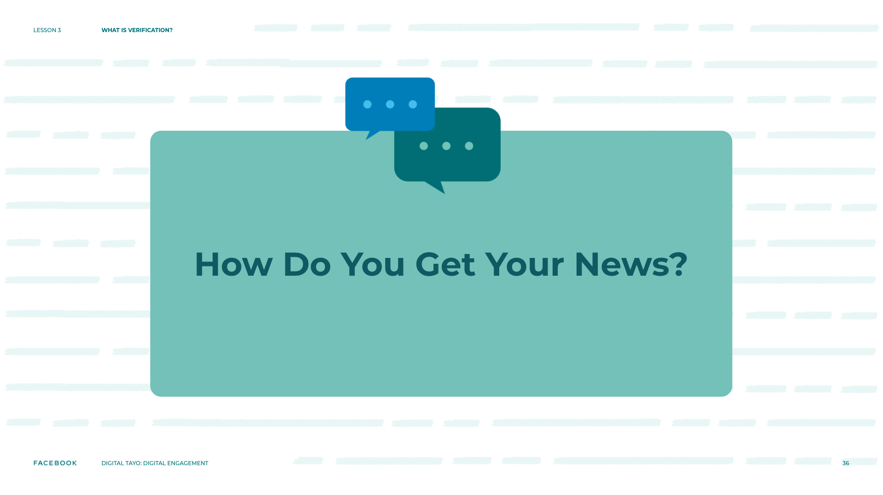
Notes:
Speaker Notes:
TELL YOUR STUDENTS
Let’s look at traditional news channels such as, newspapers, TV, and radio. Increasingly these channels have established websites, so people can access their news at any time. But there are also other ways people consume information that they consider news including social media newsfeeds such as, Facebook, Instagram, Twitter, and many others. There is an array of other ways people gather news information whether it's a podcast and something they are told by a person like a family member or friend. What we need to be mindful of is that news isn’t people’s opinion, social media newsfeeds, or private messages you receive. We need to consider the potential motivation of a news source and we need to verify information.

Slide 37

Notes:
Speaker Notes:
TELL YOUR STUDENTS
In 2016, the World News Daily Report website published an article about a National Geographic photographer who was eaten alive by a giant ocean sunfish in Peru. According to the article, 29-year-old Joaquín Álvarez Santos was on an underwater shoot with four other divers when he was swallowed whole by the fish, which weighed more than 2000 kg (4400 lbs.). One of the divers on the shoot, James C. Wyatt was said to have taken this photograph before the incident took place. Prior to our next class, spend two minutes doing a Google search of this news event to see what you can find.
TEACHER’S NOTE
If students do not have access to the internet, share the example with them and walk through the exercise.
ASK YOUR STUDENTS
What did you find?
TELL YOUR STUDENTS
You may have discovered in your search that this article is fictional. Every piece of news content has a source, which can be defined as the person, publication, or agency that captured an image or has information about the original news event.
The source of this story is the World News Daily Report website, which has a disclaimer stating that it “assumes all responsibility for the satirical nature of its articles” and that “all characters appearing in the articles in this website — even those based on real people — are entirely fictional.” However, you may have also discovered that the photograph is real. It was captured by photographer Miguel Pereira, who encountered a massive sunfish off the coast of Portugal (and lived to tell the tale) in 2013.
ASK YOUR STUDENTS
Why do you think the website published this article?
Do you think there should be a website that only publishes fictional content?
Do you think all readers will realize that World News Daily Report stories are fictional? Why/why not?

Slide 38
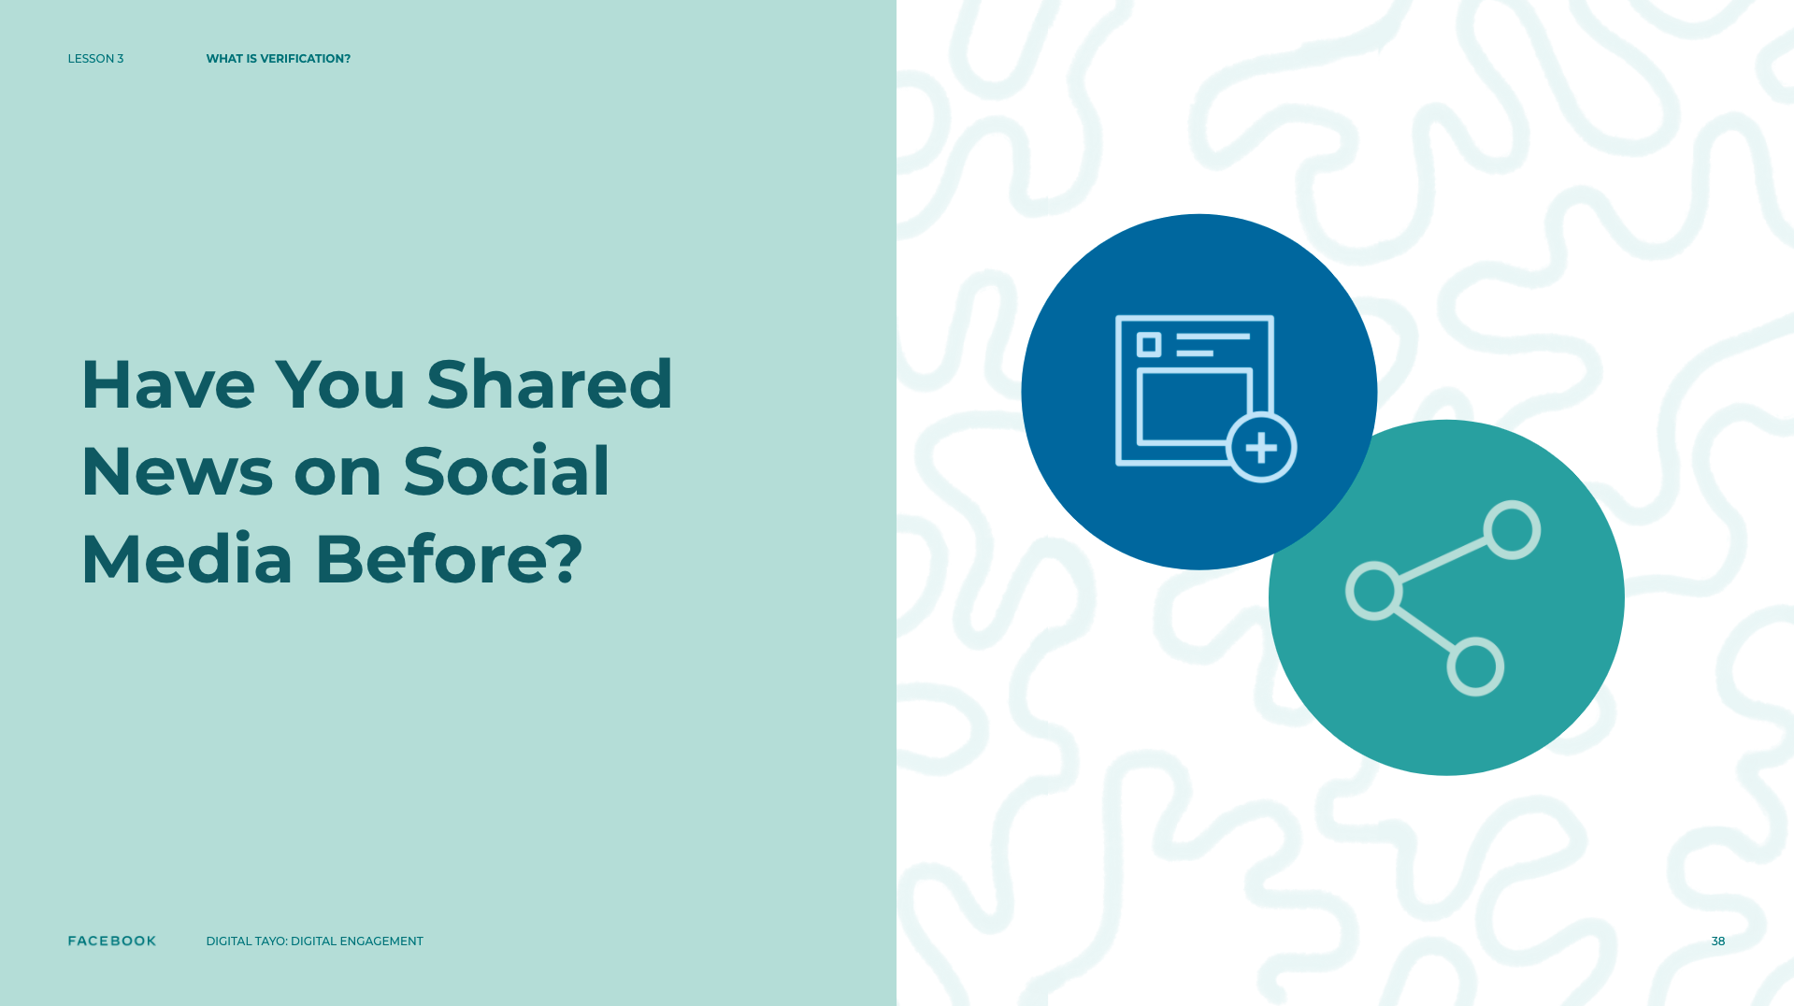
Notes:
Speaker Notes:
TELL YOUR STUDENTS
How many of you have shared news on social media before? People around the world today are reporting events on Facebook, Twitter, YouTube, and messaging apps like Snapchat and WhatsApp. Millions of people have used social media as an important tool to organize protests and engage with the news (by posting photos/videos/status updates, sharing, and commenting). Knowing how to filter and make sense of all this information is an important skill for anyone who wants to consume the news today. This skill becomes especially important because people can create, read, or even unwittingly share misinformation and fake news.
ASK YOUR STUDENTS
“Can you think of (any) news events where you were fooled by a rumor or a false image or video?” (First Draft)
What was the event?
How did you figure out that the news was fake?

Slide 39
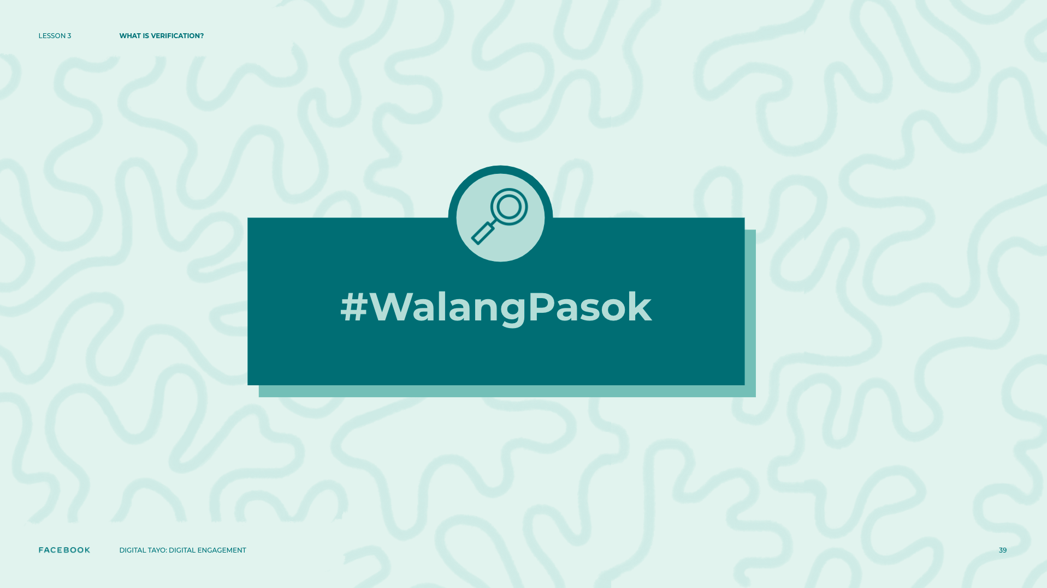
Notes:
Speaker Notes:
TELL YOUR STUDENTS
While some people intentionally try to fool news media by, for example, reposting a “no classes” or #WalangPasok announcement without looking at the date it was originally posted, other people may share the same information on social media out of a genuine interest to help or update others. “There are often so many false rumors during breaking news events that newsrooms have actually started collecting lists of them” (First Draft). Journalists are trained to remain skeptical of everything they hear and see — whether it is breaking news or viral content — until they can verify or debunk the source.
In this collection of learning experiences, you will learn how to verify information such as videos, images, and other news stories so that you can distinguish fact from fiction in the current media landscape. Verification is a process by which a news organization or a person gathers and assesses evidence to investigate if information is accurate or not. Although the process of verification used to be performed mainly by journalists and news organizations, it has become essential for anyone who wants to stay well-informed about current events. In an environment where anybody can create and share information online, especially on social media, being able to verify the content we consume and share is important for building healthy online communities and building a reputation of trust on social media.

Slide 40
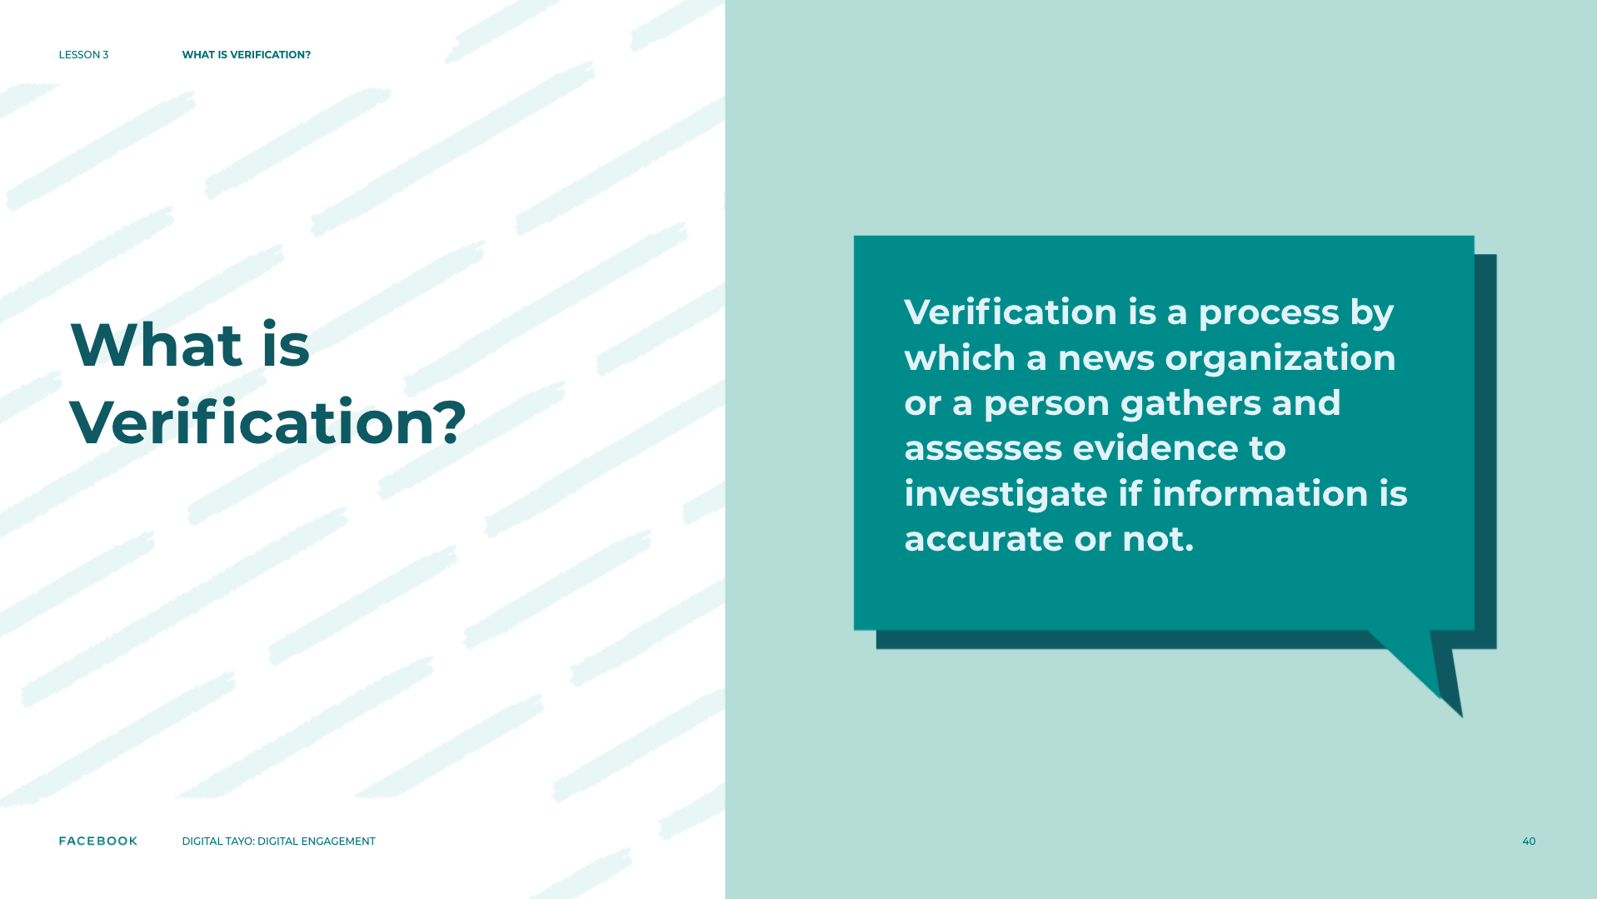

Slide 41
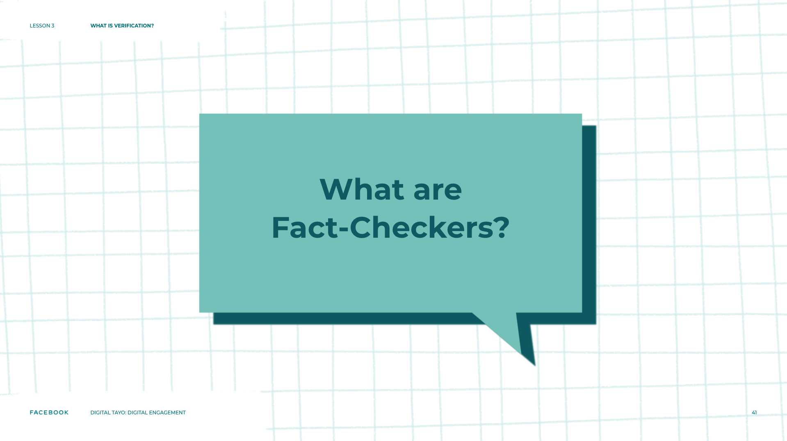
Notes:
Speaker Notes:
ASK YOUR STUDENTS
Has anyone heard of fact-checking or fact-checkers before?
What do you think fact-checkers do?
TELL YOUR STUDENTS
Fact-checkers are people who identify and then verify or refute every single fact in a piece of writing. Fact-checkers have traditionally worked for newspapers, magazines, authors, or book publishers, but in recent decades, they are increasingly verifying political content. As you can see in the First Draft article, professionals believe that the number of fact-checkers worldwide will increase in the future due to the rise of social media and user-generated news content.
Verification is examining unofficial sources on the web, sometimes known as “user-generated content,” such as when someone is at an event and then uploads video footage. Fact-checkers look at official sources: policies, government documents, speeches made by politicians, etc. All fact-checkers use some variant of the verification process. However, as previously mentioned, anyone can use the verification process when consuming the news. You can use popular websites such as Snopes and IFCN to help you verify the accuracy of news content you come across online. Leaning on all three sources to verify the story will help further confirm its accuracy.

Slide 42
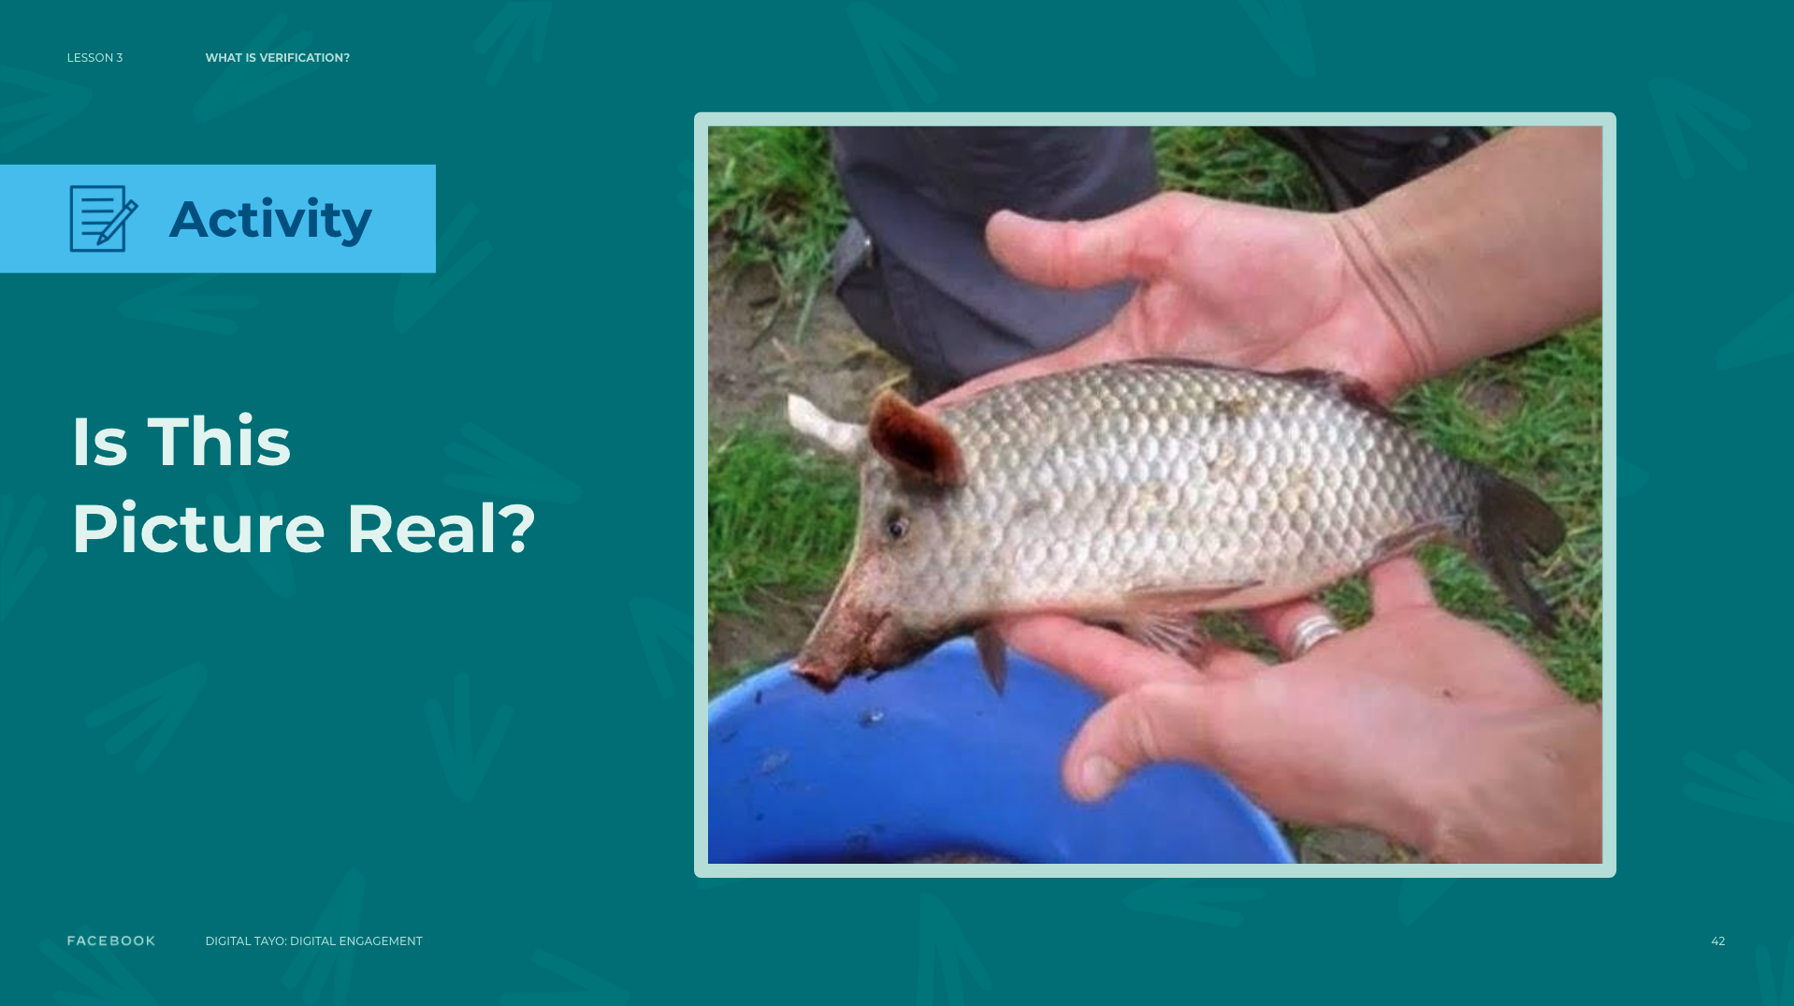
Notes:
Speaker Notes:
ASSIGNMENT
IMAGE CLASS INTERACTION
Project the pigfish image on a projection screen at the front of the room. While asking questions, ask students how identifying this image as a hoax is beneficial for publications and news consumers.
TELL YOUR STUDENTS
This image has been shared on social media sites like Facebook and YouTube with text identifying the creature as a “pigfish” or a “wild hogfish.” Visit the Snopes fact-checking website and review how fact-checkers have refuted this image as a hoax.
Write a short paragraph explaining how identifying this image as a hoax is beneficial for publications and news consumers. What might some of the consequences be for publishing unverified information? Do you think there are situations where it is appropriate for people to publish unverified information?

Slide 43
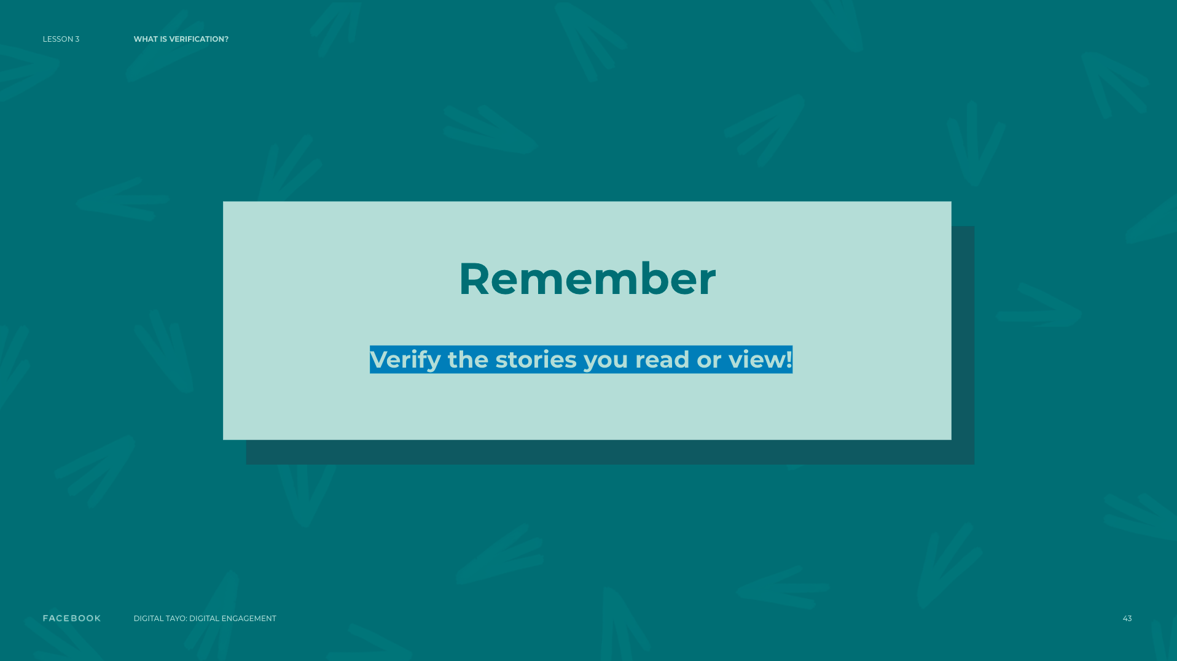
Notes:
Speaker Notes:
RESOURCES
Video by PBS NewsHour: Did fake news influence the outcome of Election 2016? - pbs.org/newshour/extra/daily-videos/why-is-it- important-for-news-sources-to-be-trustworthy
Video by First Draft: Fake news. It’s complicated - firstdraftnews.org/fake-news-complicated
Video by BBC Newsnight: The rise of ‘fake news’, manipulation and ‘alternative facts’ - youtube.com/watch?v=1aTApGWVGoI
Article by The Reporters’ Lab: The number of fact-checkers around the world: 156… and growing - reporterslab.org/the-number-of-fact-checkers- around-the- world-156-and-growing
Glossary by Youth and Media/First Draft: Information Verification Playlist Glossary - docs.google.com/document/d/1VPGGLrf2a7YMAGr-OwF0DQnA9XxAXvKB4IranXCSNHc/edit?usp=sharing
FACT-CHECKING WEBSITES
snopes.com
poynter.org/ifcn/

Slide 44
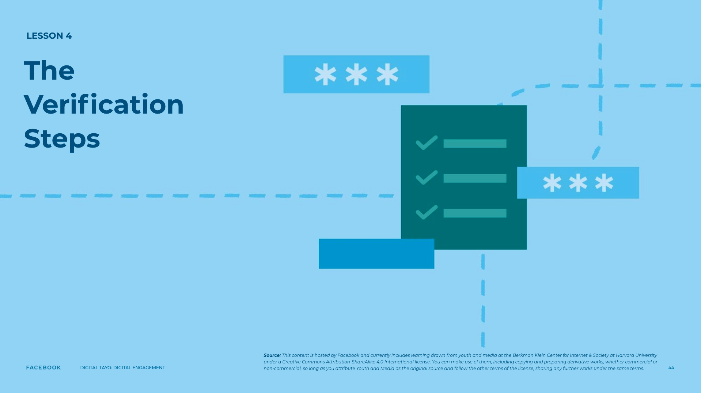
Notes:
Speaker Notes:
LESSON OBJECTIVE
Students will learn about a five-step checklist they can use to verify the origin, source, date, location, and objective of a news image or video. They will recognize the limitations inherent in the verification process and begin to consider the various online and offline tools they can use to investigate the veracity of content online. Students will reflect on how a source’s objective may affect the portrayal of a news event.
ESTIMATED TIME
30 Minutes
ESSENTIAL QUESTION
How can you check if content online is factual or not?
How can a person’s (who created content or re-shared it) potential motivation play a role in verifying online content?
MATERIALS
“Verification Checklist” Handout
“Verification Checklist” Handout - Educator’s Copy
Projector
”Braving Flood Waters to Get Married” Images
Internet Access
Additional Teacher Resources Listed
PREPARATION
Students will need internet access for this lesson.
OPTIONAL: ISTE DIGCITCOMMIT COMPETENCY
INFORMED: I evaluate the accuracy, perspective, and validity of digital media and social posts.

Slide 45
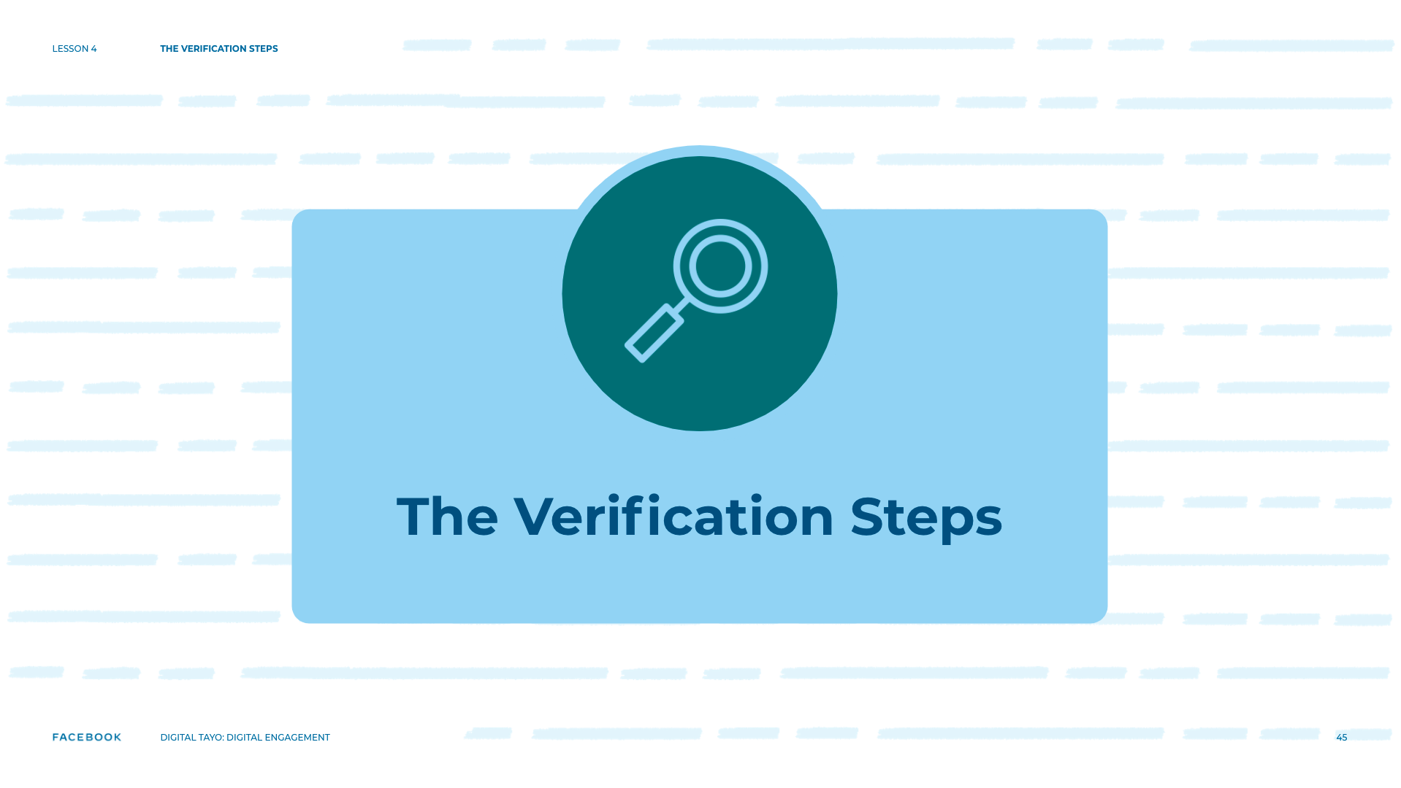
Notes:
Speaker Notes:
The Verification Steps
TELL YOUR STUDENTS
Verification is a process that is well-established in the journalism industry. In fact, organizations such as First Draft create resources that help journalists fact check and combat misinformation more effectively. The learning experiences in the verification lessons are based on content originally created by First Draft.
Today, you will learn how to verify information online through a step-by-step process professional journalists use in their own work. When verifying images or videos online, first begin by making sure that the news event in question actually took place. If you can confirm that the news event actually happened, you can then follow the Verification Checklist to verify your particular image or video.

Slide 46
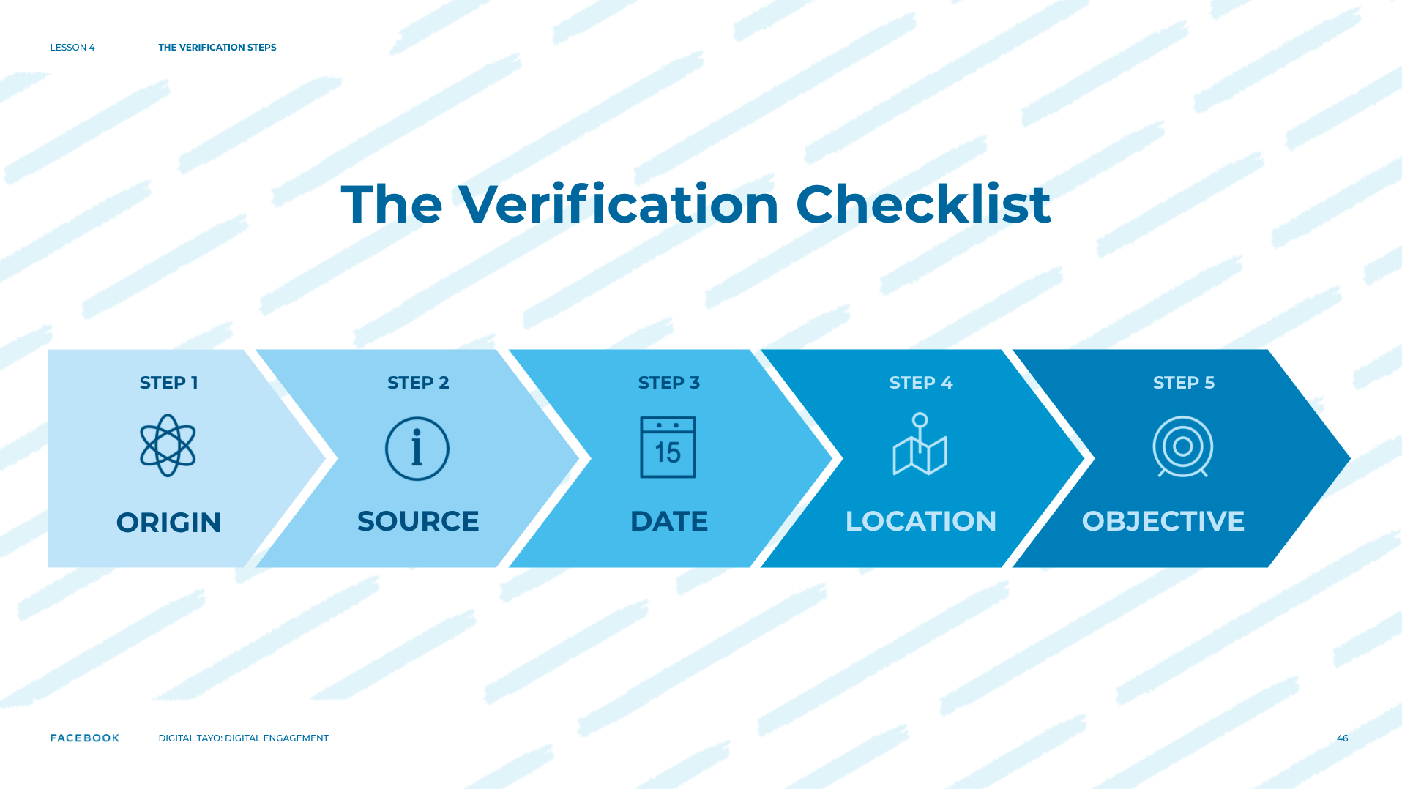
Notes:
Speaker Notes:
TELL YOUR STUDENTS
The Verification Checklist
Origin: Are you looking at the original piece of content?
Source: Who created the piece of content?
Date: When was the piece of content captured?
Location: Where was the piece of content captured?
Objective: Why was the piece of content captured?

Slide 47
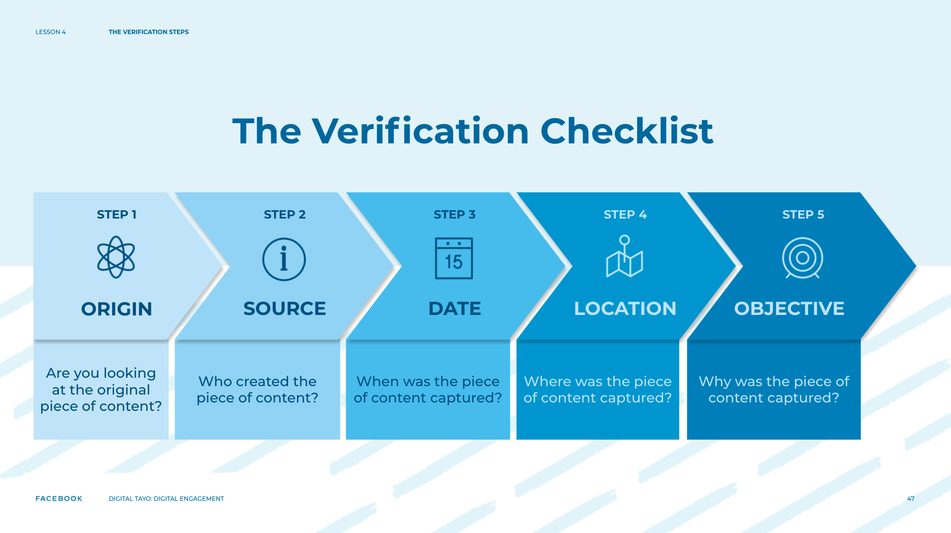
Notes:
Speaker Notes:
TELL YOUR STUDENTS
The Verification Checklist
Origin: Are you looking at the original piece of content?
Source: Who created the piece of content?
Date: When was the piece of content captured?
Location: Where was the piece of content captured?
Objective: Why was the piece of content captured?

Slide 48

Notes:
Speaker Notes:
TELL YOUR STUDENTS
1. Origin: Run this check first to determine whether you are looking at the original piece of content, rather than a reproduction. As you will learn later on in this lesson, the original image or video contains important information relevant to the verification process that copies or screenshots will not have. This can sometimes be challenging, especially when analyzing memes where it's almost impossible to locate the original.

Slide 49
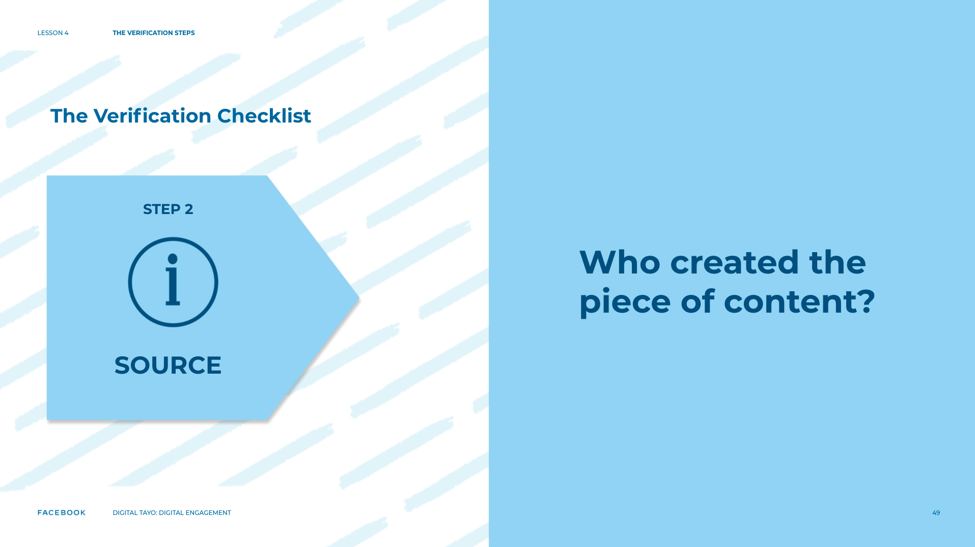
Notes:
Speaker Notes:
TELL YOUR STUDENTS
2. As you learned in the previous lesson, every piece of news content has a source, which can be defined as the person, publication, or agency that captured an image or has information about the original news event. When determining the source, make sure to differentiate between who captured the content originally and who uploaded the content. Many people today have large digital footprints and journalists often try to connect the dots between people’s different social media accounts in order to find information such as a person’s contact information or a person’s location during a news event.

Slide 50
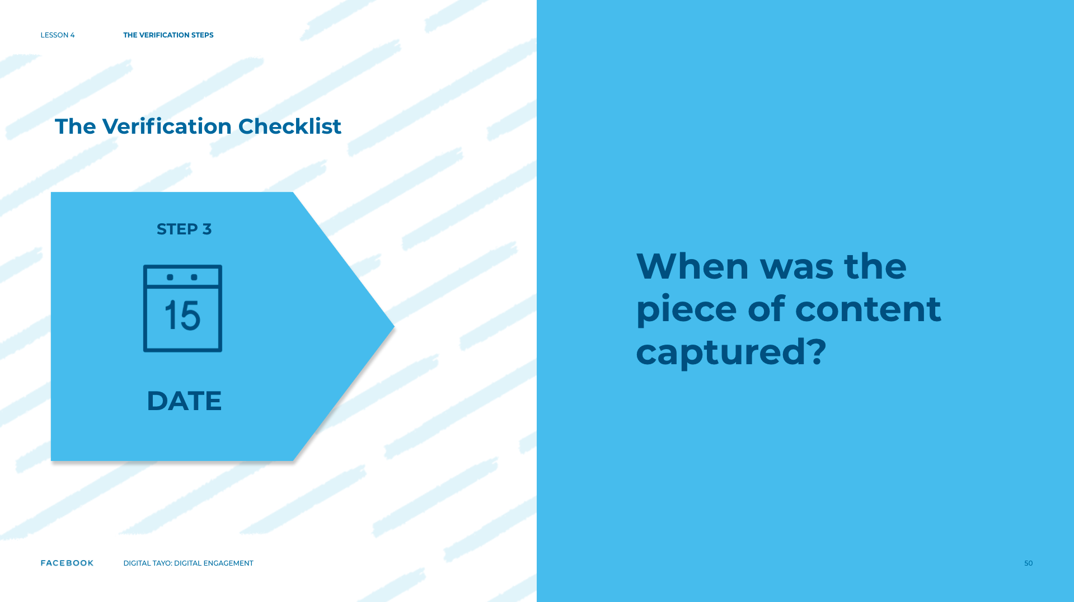
Notes:
Speaker Notes:
TELL YOUR STUDENTS
3. Date: Although it can be difficult to identify the date an image or video was captured (vs. when it was uploaded), news organizations have been criticized in the past for confusing these two dates. With the rise of smartphones, people can immediately post an image after capturing it, but that is not always the case.

Slide 51

Notes:
Speaker Notes:
TELL YOUR STUDENTS
4. Location: Social media platforms allow users to tag a particular location to a post, but this information can easily be manipulated. The best way to verify a post’s location is to independently find it on a map or a satellite image.

Slide 52
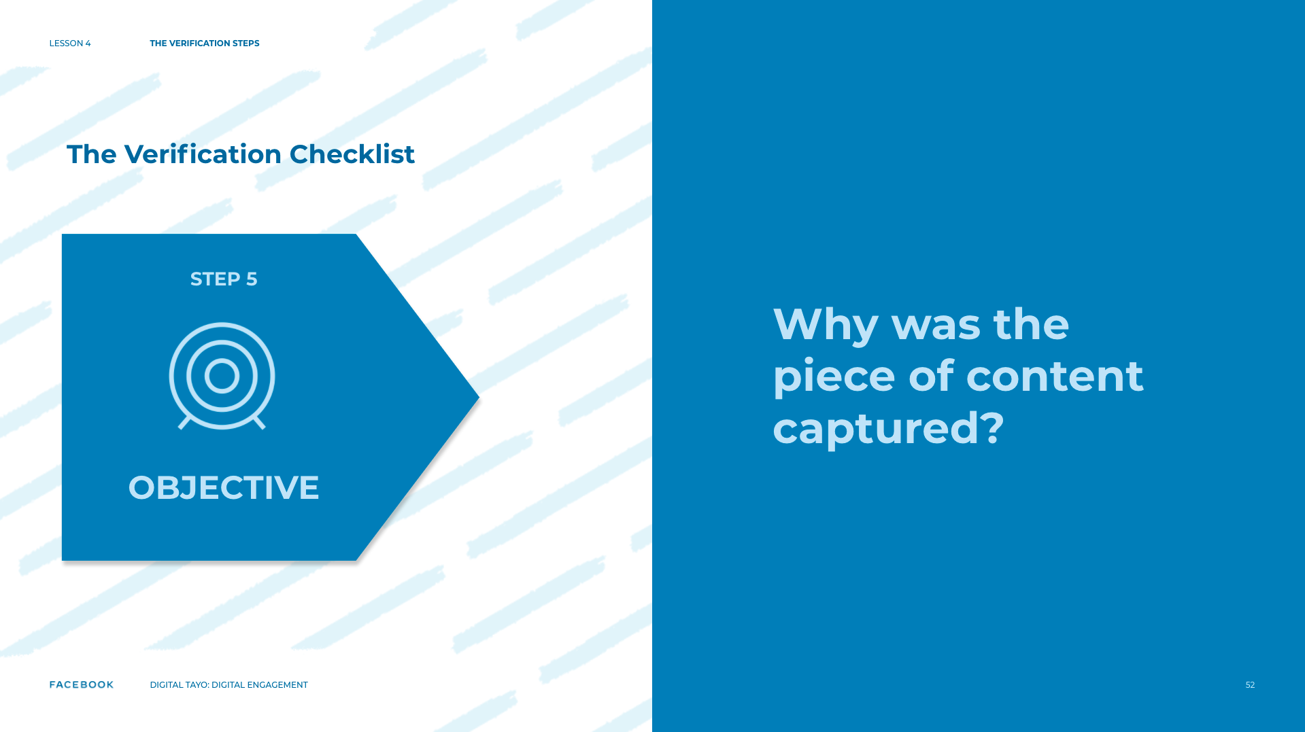
Notes:
Speaker Notes:
TELL YOUR STUDENTS
5. Objective: As you do in history class, work to understand the perspective and objective of the source. Is the source of the image or video an accidental eyewitness? A field officer working for the UN? An activist? Your answer to this question can affect how you view the larger news story.
ASK YOUR STUDENTS
Why is it important to identify the potential objective of a news source?
What are potential situations where you might question the objectives of a news source?
For younger students, consider providing one of the examples below before asking them to think of additional examples.
News consumers might not question the objective of a journalist, but it is important to consider why they might have written their article before taking it as fact. For example, is the journalist praising someone running for office and also related to that person? Would that change the way you view the article they wrote.
TELL YOUR STUDENTS
After you finish using the checklist, you will get a better sense of how confident you should be in posting or sharing content online. It may be the case that you are 100% sure of a video’s location, but you are not 100% sure that you have the original version. You might have concerns that the person who uploaded an image was not the person who captured it. The verification process might not always lead you to a definitive “yes.” Instead, it is a process where you search for clues and connections and where you use a variety of tools that lead you to build a case for why a piece of content can be trusted.

Slide 53
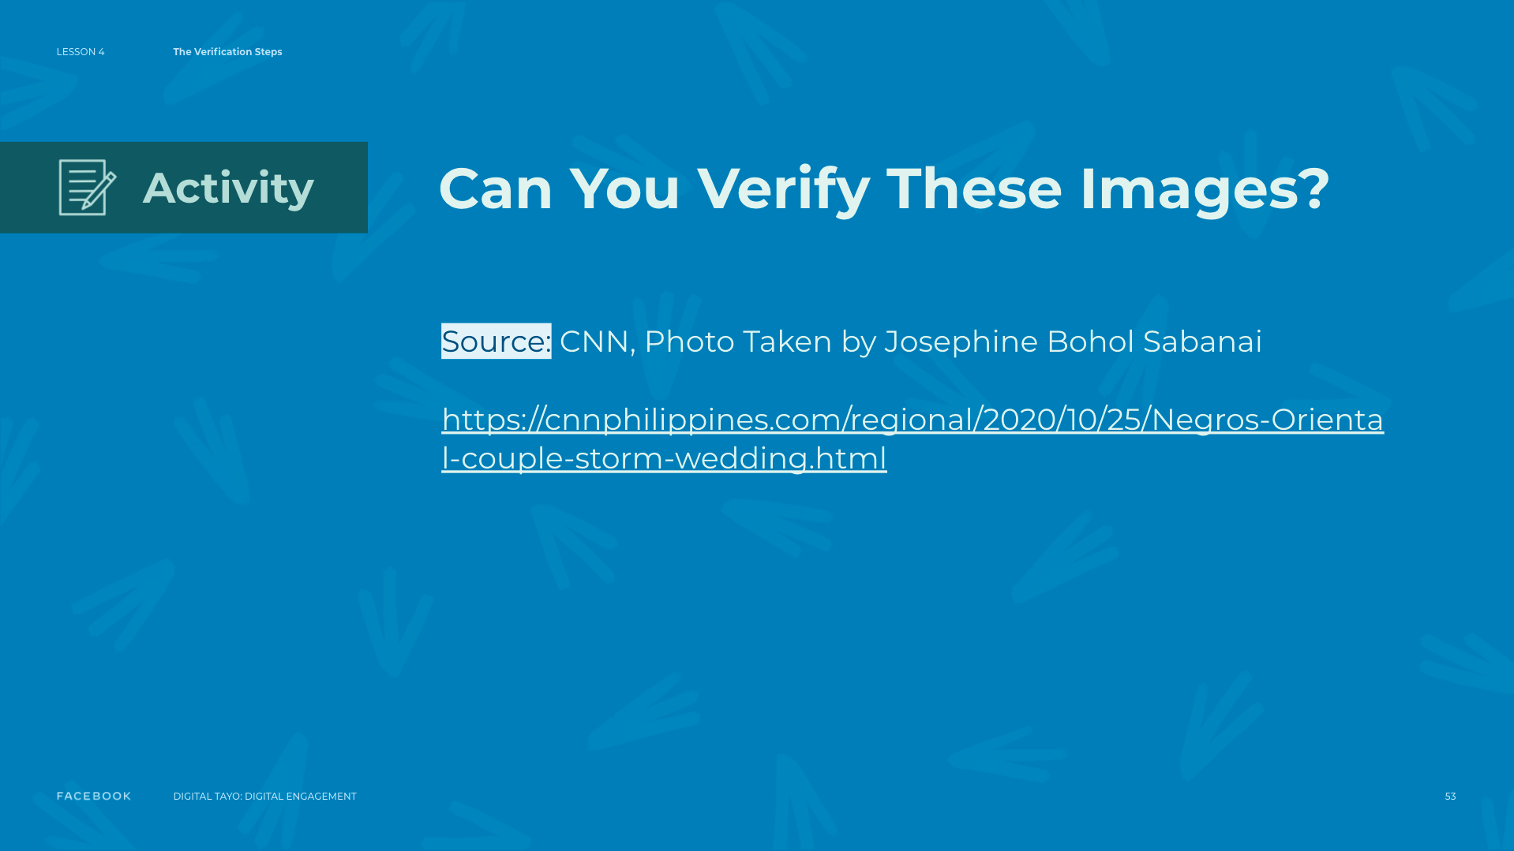
Notes:
Speaker Notes:
ASSIGNMENT
TEACHER’S NOTE
Review the article below with your students. Put students in groups of two or three and pass out the “Verification Checklist” handout.
CNN, Photo taken by Josephine Bohol Sabanai - https://cnnphilippines.com/regional/2020/10/25/Negros-Oriental-couple-storm-wedding.html
ASSIGNMENT
Use the “Verification Checklist” for reference. With your partner or group, fill out the “Verification Checklist” handout and ask yourself how you could figure out the answer to each question. What online or offline tools could you use to help you? Who would you talk to? What clues are in the photo that can help you?
TELL YOUR STUDENTS
Let’s share our findings. Raise your hand if you believe your group found the original version of the image.
ASK YOUR STUDENTS
What site do you think has the original?
How did you determine whether or not this image was the original piece of content?
TELL YOUR STUDENTS
When a news event occurs, images and videos can easily multiply, with the same person being photographed by multiple people from different angles. Each person who captures and shares a piece of content can be motivated to do so for various reasons. For example, photos of the same event can be captured by a journalist, an activist, a person who works in the area, or a person who is traveling through the area on holiday. Each resulting image can reflect the different interests, opinions, and even potential biases of its source.
ASK YOUR STUDENTS
How might you go about identifying and verifying the source of other images?
Compare the objectives of the sources who captured the photographs of a couple braving the flood waters to attend their wedding. How might a source's objective affect how an image or video?

Slide 54
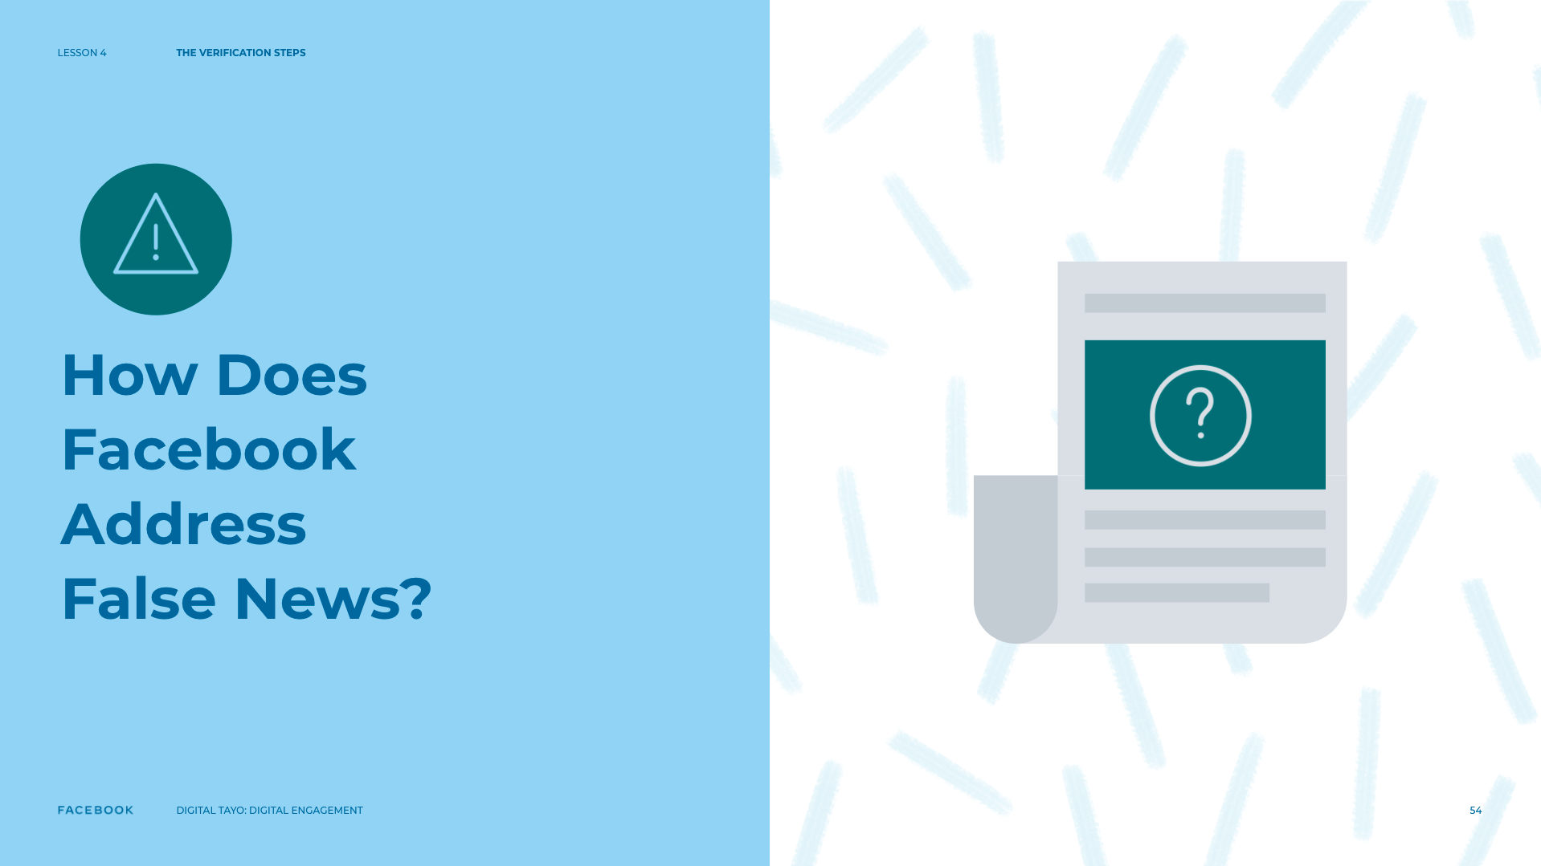
Notes:
Speaker’s Notes
TELL YOUR STUDENTS
Facebook is committed to fighting the spread of false news on Facebook.
They use both technology and human review to remove fake accounts, promote news literacy, and disrupt financial incentives of spammers.
In certain countries, they also work with third-party fact-checkers who are certified through the non-partisan International Fact-Checking Network to help identify and review false news.
Being media literate is like being able to read. But a media literate person can ‘read’ all types of media — including broadcast media like television and radio, print media like newspapers, and information on the internet.
A media literate person does not just access media. They have to be able to understand it, analyze it, think about it critically — and create it themselves.
To become media literate we need to be able to think critically about what the information is, where it came from, and why it was made.
Digital information can sometimes be manipulated to change its meaning. So, we need to learn how to spot false information and how to tell the difference between a fact and someone’s opinion.

Slide 55
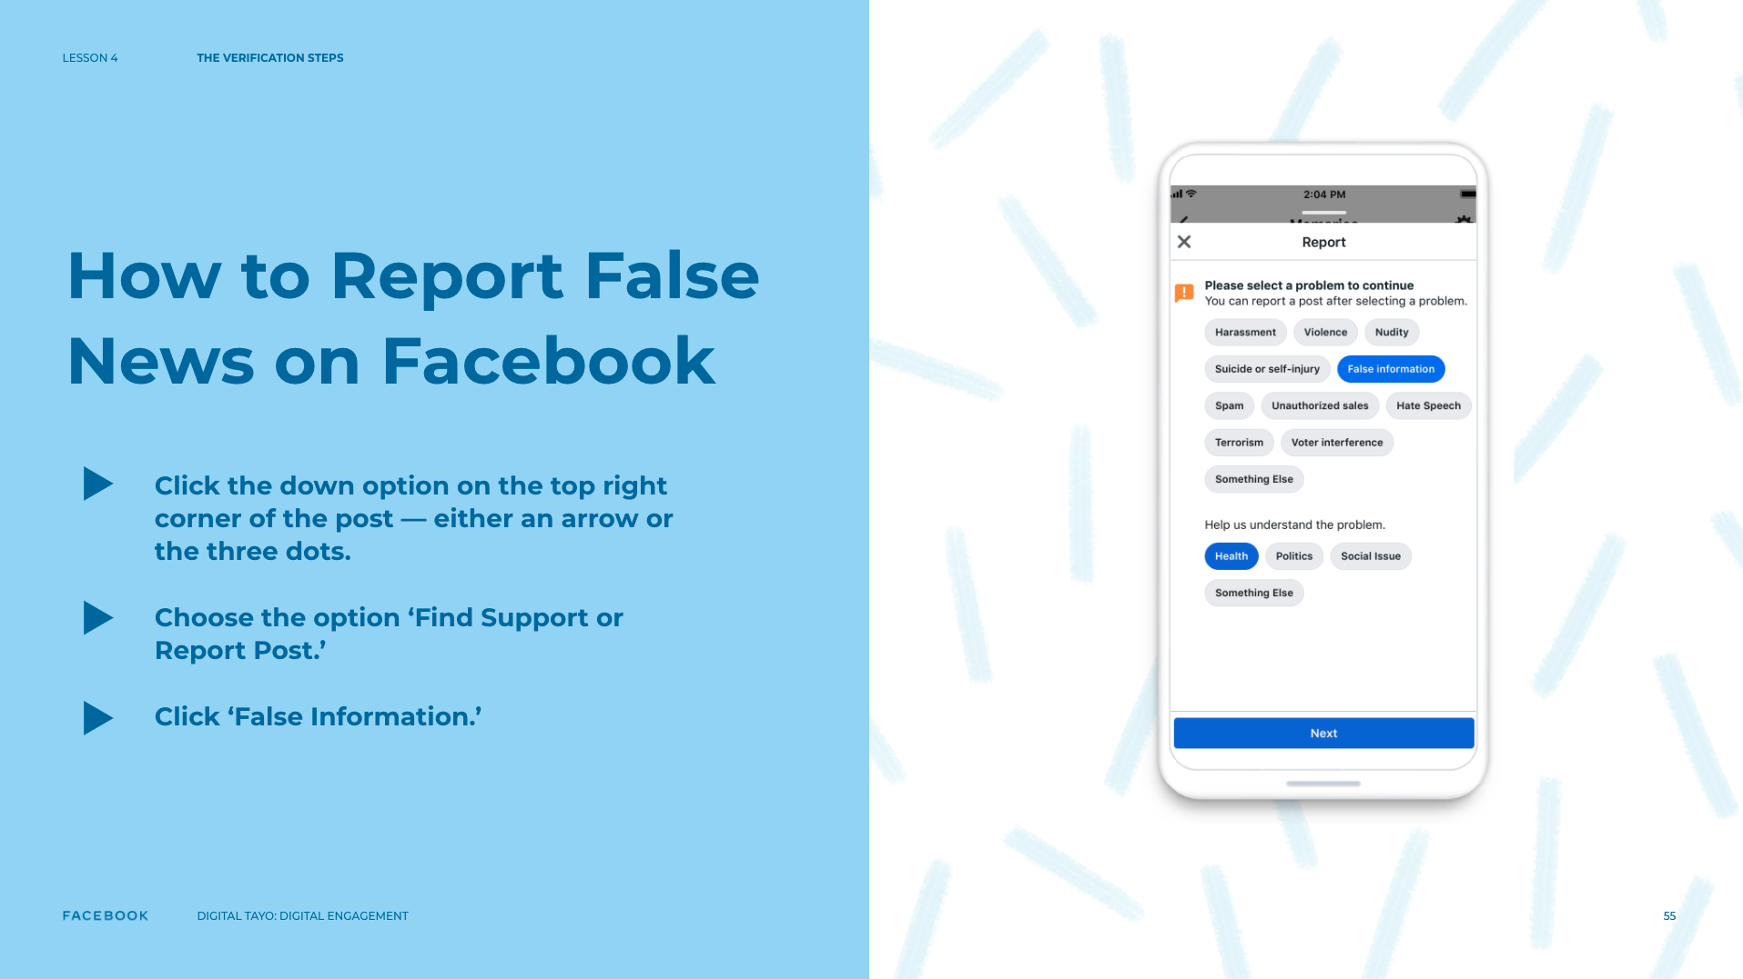
Notes:
Speaker’s Notes
ASK YOUR STUDENTS
How to report false information on Facebook?
TELL YOUR STUDENTS
Grab your phone.
Look at a post.
Click the down option on the top right corner of the post — either an arrow or the three dots.
Choose the option ‘Find Support or Report Post.’
Click ‘False Information.’
These reports help us better identify potential false news on Facebook.

Slide 56

Notes:
Speaker’s Notes
TELL YOUR STUDENTS
The other thing to look at when viewing information is whether a post is organic or an Ad from a business.
Organic means the post has been posted for free and is not a paid advertisement.
When a post has ‘sponsored’ at the top, that means whomever posted it has paid to do so and it also means the post has passed through additional review to ensure it isn’t False Information.

Slide 57

Notes:
Speaker’s Notes
TELL YOUR STUDENTS
Let’s take a quick look at how you can report ads or people’s posts for being misleading or false news etc. on Instagram.
On the screen, you can see a personal post and a sponsored post.
To report the post, start by clicking the three dots on the top right corner of the post.
Now you can see the options available for both types of posts for reporting.

Slide 58

Notes:
Speaker’s Notes
TELL YOUR STUDENTS
Facebook is working to reduce the distribution of false news by:
Identifying false news: Facebook identifies news that may be false using signals like reports from people on Facebook. Fact-checkers may also identify stories to review on their own.
Reviewing stories: Fact-checkers will review stories, check their facts, and rate their accuracy.
Showing false stories lower in News Feed: If a fact-checker rates a story as false, it will appear lower in News Feed. This significantly reduces the number of people who see it.
Taking action against repeat offenders: Pages and websites that repeatedly share false news will see their distribution reduced and their ability to advertise removed.

Slide 59

Notes:
Speaker’s Notes
TELL YOUR STUDENTS
Let’s now take a look at how you can identify messages that have been forwarded on WhatsApp.
When a message has been forwarded many times, its source might be unclear. When you don’t know the source you should verify the information.
As you can see, the message indicates whether the message has been forwarded.

Slide 60

Notes:
Speaker’s Notes
TELL YOUR STUDENTS
Facebook has also included added functionality to identify False information.
If someone does post false information, it can be identified and the viewer will be notified when they see the item in the News Feed.
RESOURCES
Video by factcheck.org - youtube.com/watch?v=AkwWcHekMdo
Checklist by Youth and Media/Verification Checklist https://docs.google.com/document/d/1xp4-0cpVM_00ufanK2mSPGW-vyFo1ahslZOQdnMBjY4/edit?usp=sharing
CNN, Photo taken by Josephine Bohol Sabanai - https://cnnphilippines.com/regional/2020/10/25/Negros-Oriental-couple-storm-wedding.html

Slide 61

Notes:
Speaker Notes:
LESSON OBJECTIVE
Students will be able to define what a scrape (a copy from an original) is and explain why the proliferation of this type of media text can make the verification process more difficult during breaking news events. They will create and share their own scrapes online as they reflect upon when it is important to identify a scrape’s source or a news event’s original context.
ESTIMATED TIME
45 Minutes
ESSENTIAL QUESTION
Why and how can it be helpful to identify an original image online and copies of it made afterwards?
Looking at the original image and the copies that followed, what potential story might this tell?
MATERIALS
”Braving Flood Waters to Get Married” Image
Internet Access
Additional Teacher Resources Listed
PREPARATION
Students will need internet access for this lesson.
OPTIONAL: ISTE DIGCITCOMMIT COMPETENCY
INFORMED: I evaluate the accuracy, perspective, and validity of digital media and social posts.

Slide 62

Notes:
Speaker Notes:
TELL YOUR STUDENTS
You previously learned about the five-step verification checklist professional journalists use when they want to verify an image or video. (Quickly recap with students the five items on The Verification checklist.)
Origin: Are you looking at the original piece of content?
Source: Who created the piece of content?
Date: When was the piece of content captured?
Location: Where was the piece of content captured?
Objective: Why was the piece of content captured?

Slide 63

Notes:
Speaker Notes:
Today, we will talk about the first two items on the checklist: origin and source. In the current media landscape, people are constantly creating, sharing, and adapting media content, especially on social media platforms. Journalists and news consumers can use a variety of tools to verify an image or video and determine whether it has been used in the correct context. That is why we consider verification to be a process — because verifying content involves multiple steps and it can sometimes take a long time to complete. One challenge people face when it comes to verifying content is that photos and videos circulate from platform to platform and can easily be modified, copied, and taken out of context.

Slide 64

Notes:
Speaker Notes:
ASK YOUR STUDENTS
Have you ever copied an image or video from one platform and shared it on another one?
Have you ever posted something a friend shared with you on a different platform?
Have you ever deleted something and then reposted it at a later time?

Slide 65

Notes:
Speaker Notes:
TELL YOUR STUDENTS
Scrapes are pieces of content that are copied from an original and sometimes move from one platform to another. The term comes from the verb “to scrape,” and it refers to a piece of content that is copied by a user to create a new version of the content.
(Scrapes are also called copies or versions of media texts. If you/your students want to find more resources about scrapes online, you can also use these other terms. Elsewhere in this learning experience, we have decided to refer to scrapes as “scrapes (versions)” to reflect this multiplicity of terms.)

Slide 66

Notes:
Speaker Notes:
TELL YOUR STUDENTS
Imagine you are sharing a photo you captured on a closed messaging platform, like Snapchat or WhatsApp, and then one of your friends takes a screenshot of it and posts it onto a more “public” platform like Twitter. Let’s say a journalist found your friend’s screenshot and wanted to find out who took the photo.
Optional: Ask students to turn to the person sitting next to them to discuss these questions in pairs.
ASK YOUR STUDENTS
How could the journalist find out that you are the original creator?
What if your friend’s post became popular and 50 other people shared it? How could the journalist find out who the original creator is? (The journalist could contact your friend and ask if he/she took the photo. If the journalist has found multiple scrapes (versions) of the image, he/she may look at the date each scrape was posted and try to contact the person who made the earliest post.)

Slide 67

Notes:
Speaker Notes:
TELL YOUR STUDENTS
Scrapes (versions) can become a problem during breaking news events because information can spread very quickly and it can be difficult to figure out who originally created the content and when it was created. On websites like YouTube, some people will download an original video of a news event and quickly re-upload it using a different username, in hopes of making money (First Draft). “You can sometimes see hundreds of (versions) of the same video in the hours after a breaking news event” (First Draft).
TELL YOUR STUDENTS
When you first come across a piece of content, you cannot assume that you are looking at the original. Look for clues such as the following that can tell you whether the image or video is the original version:
Scrapes (versions) generally have lower image or video quality compared to the original version. They can also have smaller file sizes or nonstandard dimensions (which indicates that the content may have been manipulated or changed from the original).
Look at the account of the person who is sharing the image or video. Do they share other scrapes (versions) of breaking news events? That probably means that they are not the original creators of the content.
Does the image or video come from an organizational website? Organizations “can sometimes reshare content from an individual eyewitness” (First Draft).
Finally, check your gut. Is it likely that this person was at the event and is sharing the original video?

Slide 68

Notes:
Speaker Notes:
OPTIONAL ASSIGNMENT
TELL YOUR STUDENTS
Go online and find an image from a recent news event that interests you. Identify the source of the image. Make a scrape of the image and share it on one of your social media accounts. When posting the image, you can choose to adapt the image in any way (e.g., edit, crop, add text) before you share it. When posting the image, be sure to identify its original source.
Then write a short paragraph answering the following questions:
What image did you decide to share and why?
Where and with whom did you share the image?
Did you choose to alter (e.g., edit, crop, add text) the image in any way before sharing it? What was your objective behind adapting/not adapting the image?
Do you think your post would have different reactions if you did not identify the original source? Why or why not?
TELL YOUR STUDENTS
Turn to the person next to you. Share the image you posted and briefly explain why you chose this particular image.
ASK YOUR STUDENTS
What are some of the reasons people might choose to reshare content online?
Think of other famous scrapes (versions) you have seen people share online. Are there instances when identifying a source is more/less important than others? Talk through some examples as a class and discuss whether they are harmful or not.

Slide 69

Notes:
Speaker Notes:
Discussion
IMAGE CLASS INTERACTION
In today’s news climate, any image or video can be captured, altered, or shared by anyone with access to the internet and a computer or mobile device. In some cases, the content in question can be seen by countless people and altered again and again in such a way that the original image is almost unrecognizable. One particular instance of this phenomenon can be seen when scrapes (versions) become popular memes.
TEACHER’S NOTE
Review the article below with your students.
CNN, Photo taken by Josephine Bohol Sabanai - https://cnnphilippines.com/regional/2020/10/25/Negros-Oriental-couple-storm-wedding.html
CLASS INTERACTION
Consider this image of a couple on their way to their wedding.
TELL YOUR STUDENTS
This couple went viral after photos emerged of them braving the floods from a typhoon to make their wedding ceremony.
These photos were then shared by others rapidly online through websites and social media, without properly identifying who the couple was, when the image was taken, or where the event took place.
Some of these scrapes (or versions) have been turned into popular memes that have been featured in major publications. However, most of the memes you see often require some knowledge of the picture's original context. As a result, people who see this image in isolation, may not fully understand the intention of the meme, the message behind it, or even its origins.
ASK YOUR STUDENTS
Think of some famous scrapes (versions) that have become memes. Do you have any favorites?
Are you familiar with the original source of this meme? What about the original context?
TELL YOUR STUDENTS
Visual information, even more so than text, is designed to grab people’s attention on social media. As a responsible news consumer, you can decide how best you want to engage with, share, or adapt content that you see your friends, family, and other people are posting online.

Slide 70

Notes:
Speaker Notes:
ASK YOUR STUDENTS
Based on what you have learned about scrapes (versions) today, how will you respond to scrapes and memes you see in the future?
RESOURCES
Video by First Draft: The challenge of dealing with scrapes - youtube.com/watch?v=KoDCwBk90Hc
CNN, Photo taken by Josephine Bohol Sabanai - https://cnnphilippines.com/regional/2020/10/25/Negros-Oriental-couple-storm-wedding.html
Article by Alastair Reid (First Draft): Several news outlets duped into publishing old flight turbulence footage - firstdraftnews.org/several-news-outlets-duped-into-publishing-old-flight-turbulence-footage
Article by Alastair Reid (First Draft): Why eyewitness media is central to the future of the news industry - firstdraftnews.org/why-eyewitness-media-is- central-to-the-future-of-the-news-industry
Article by Malachy Browne (First Draft): A pocket guide for verifying details of a video - firstdraftnews.org/a-pocket-guide-on- verifying-details-of-a-video

Slide 71

Notes:
Speaker Notes:
LESSON OBJECTIVE
Students will imagine and write about what their lives will be like 10-20 years from now.
ESTIMATED TIME
20 Minutes
ESSENTIAL QUESTION
What are some ways you can become your best possible self?
Why is it important to think about this now?
MATERIALS
“Best Possible Self” Handout
Writing Materials
PREPARATION
Take a moment to identify the three most important values to you listed on the handout. Why are these values so important to you? How do they influence your daily life and your long-term plans?
OPTIONAL: ISTE DIGCITCOMMIT COMPETENCY
INCLUSIVE: I am open to hearing and respectfully recognizing multiple viewpoints and I engage with others online with respect and empathy.

Slide 72

Notes:
Speaker Notes:
TELL YOUR STUDENTS
You are going to do an exercise that will allow you to be as creative as you want to be: You’re going to imagine what your life might be like 10-20 years from now.
CLASS INTERACTION
Start by inviting students to close their eyes or to look at a spot on the floor in front of them and to take a few deep breaths.

Slide 73

Notes:
Speaker Notes:
ASK YOUR STUDENTS
Take a moment to imagine your life 10-20 years from now. Things have gone as well as you possibly could have hoped. Silently visualize your answers to my next questions.
What will you be doing?
Who will be in your life?
What will be most important to you?
CLASS INTERACTION
Give students the “Best Possible Self” handout and ask them to complete it on their own. When students have finished, give students the opportunity to share either their writing or their thoughts about this process with each other or with the whole class, if they feel comfortable doing so.
ASK YOUR STUDENTS
Ask students to reflect on whether this exercise confirmed their sense of purpose or, if they aren’t sure of their purpose, did it give them any clues or insight into what their purpose might be?
Understanding our sense of purpose, can not only help us in our daily lives, but it can also ensure we are practicing positive online engagement that showcases our best possible self and drives toward our purpose.

Slide 74

Notes:
Speaker Notes:
ASSIGNMENT
(in class or homework)
Reflection After the Practice
How did students respond to this practice? Did they find it helpful in helping them decide what their purpose might be?
Source: The Purpose Challenge Toolkit was created by Dr. Kendall Cotton-Bronk in partnership with the Greater Good Science Center and Prosocial. kendallcottonbronk.com
For more information, visit purposechallenge.org.
ggie.berkeley.edu/practice/best-possible-self

Slide 75

Notes:
Speaker Notes:
The lessons and activities in this section help students build safe, supportive, and inclusive online communities. A critical skill in this area is being able to identify and share reputable sources. Core skills include perspective-taking, critical thinking, respect and empathy, building healthy relationships, and media literacy.

